Slide 1
Read their papers and analysis a bit.??????????????????????????
Blocking visual feedback of movement - ??????????????????? Can increase the UC effect since participants will find it harder to correct mistakes in time?
What UC processing was it? Semantic?...
Lexical – No, because it deals with word/nonword.
Phonological – No, because words are completely identical, instead of partial parts with similar sound.
Morphology – No, because it deals with suffixes, prefixes, stems…
Visual/shape – No, words are of different font.
Semantic – perhaps, because words are of different font, so their meaning has to be extracted to create facilitation/inhibition.
Velocity – are incongruent trials slower = less confident? Speed should be inconsistent in incongruent (sub are first not sure what to select and than have to increase speed to compensate once they decide), but consistent in congruent. However, changes in speed could occur when direction changes regardless of confidence. To verify this is not what creates the effect we can add the num of direction changes to the regression analysis.
Can also be used to detect changes of mind: sudden increase / decrease in velocity.
Technical questions about tracking???????????????????????????
FDA – performing an ANOVA at each point along the traj. Stopped using it because it didn’t produce interesting results. deviated to other variables.
However I should check it again now that I have many participants.
But the analysis code has changed and I need to check again if the FDA analysis still fits the current structure of the data.
To conclude, do you think motion should be used? Why?
Currently, no.
Since it produces similar effect sizes to keyboard, but is more complicated to implement,
The main motivation for using it would be its ability to delineate the development of cognitive processes,
But in my data I did not find specific windows in which UC applies its influence.
To improve the chance for dynamic differences between conditions, you should use:
Dynamic starting condition – evidence will take effect as soon as it is received,
Further investigate heading angle – ??????????????????????????
Change SOA – does it affect the point In which conditions start to differ?
Static start – if it changes the point at which congruency effect starts, it implies what is the delay until the prime starts to exert its influence.
if it doesn’t???? Then prime shift processing to a certain state, and the target takes constant time to exit this state.
dynamic start – Hopefully longer SOAs will allow prime to exert its effect to higher degree.
Time analysis can be done with a keyboard by playing with the SOA, why use motion tracking?
It tracks processes as they occur, instead of drawing conclusions retrospectively, this allows us to find the order in which cognitive processes occur.
We can probe the cognitive processes directly, not infer indirectly.
Inferring time of clusters
Normalization returns time at each re-sampled point (separated for condition and side).
Average this time between trials.
Time analysis can be done with brain imaging.
But motion tracking is less expensive. Especially if you use only 2d with a simple camera and image analysis.
Why did you normalize in space? What artifact is created when normalizing in time? Explaine in detail.
You need to normalize so that you can average over space/time.
If you normalize by dividing all point by value X, it won’t work since some trajs last longer than others, so you would points that exist in one traj but not in the other.
If you normalize by sampling X points equally spaced in time/space, you need to be carefull about your interpretation. Everything is relative to each traj’s duration/length. If you find that one condition started earlier, that means it started earlier relative to its entire duration / length. A contrasting example, if one traj takes 400ms and deviation starts at 300ms, it would look the same as a traj in which deviation started at 600ms and the traj lasted 800ms. So you would falsely deduce these two trajs are the same.
This also applies for space, but in space the path (along Z) is relatively constant between trajs so these problems would be minor.
In track it to crack it they say that the variable you normalize by shouldn’t correlate with the conditions, this will create false effects.
??????????????? Look again in “track it to crack it”: Time versus Space Confound ????????????????????
Averaging trials
Average doesn’t represent the actual traj, because it can contain different types of trajs with different characteristics.
This can be investigated by clustering together similar trials (e.g. machine learning clustering algorithms and using the x as the variable).
Which statistical analysis did you use? Why? (remember permutation for non-normal t tests) t test isn’t suited for small samples.
t-test - Congruency effect
Permutation - Violators of normality. Explain what is permutation.
Tree-BH – correction for multiple comparisons. Bottom up to fill p-values. Top down to test for significance.
Permutation + clustering – 1. compute t-value for each point along trajectory.
2. Cluster together significant points.
3. Shuffle signs of participant’s congruency effect at which point.
4. re-Compute t-value and cluster
5. take max cluster size and add to distribution.
Repeat 3-5 to build noise distribution
Divide Alpha by num of permutation procedures.
Check if original clusters are at a percentile further than new alpha.
Test for outliers – non found. If found, use robust t-test using R's WRS2 , and effect size “APK”.
Test for normality – if violated, replace t-test with permutation test.
How would you delineate the processes in time? By using SOA.
How does it relate to consciousness theories?

Slide 2


Show some sensitivity!
Using motion tracking to explore unconscious measures
Khen Heller
Under the supervision of Liad Mudrik

Slide 3

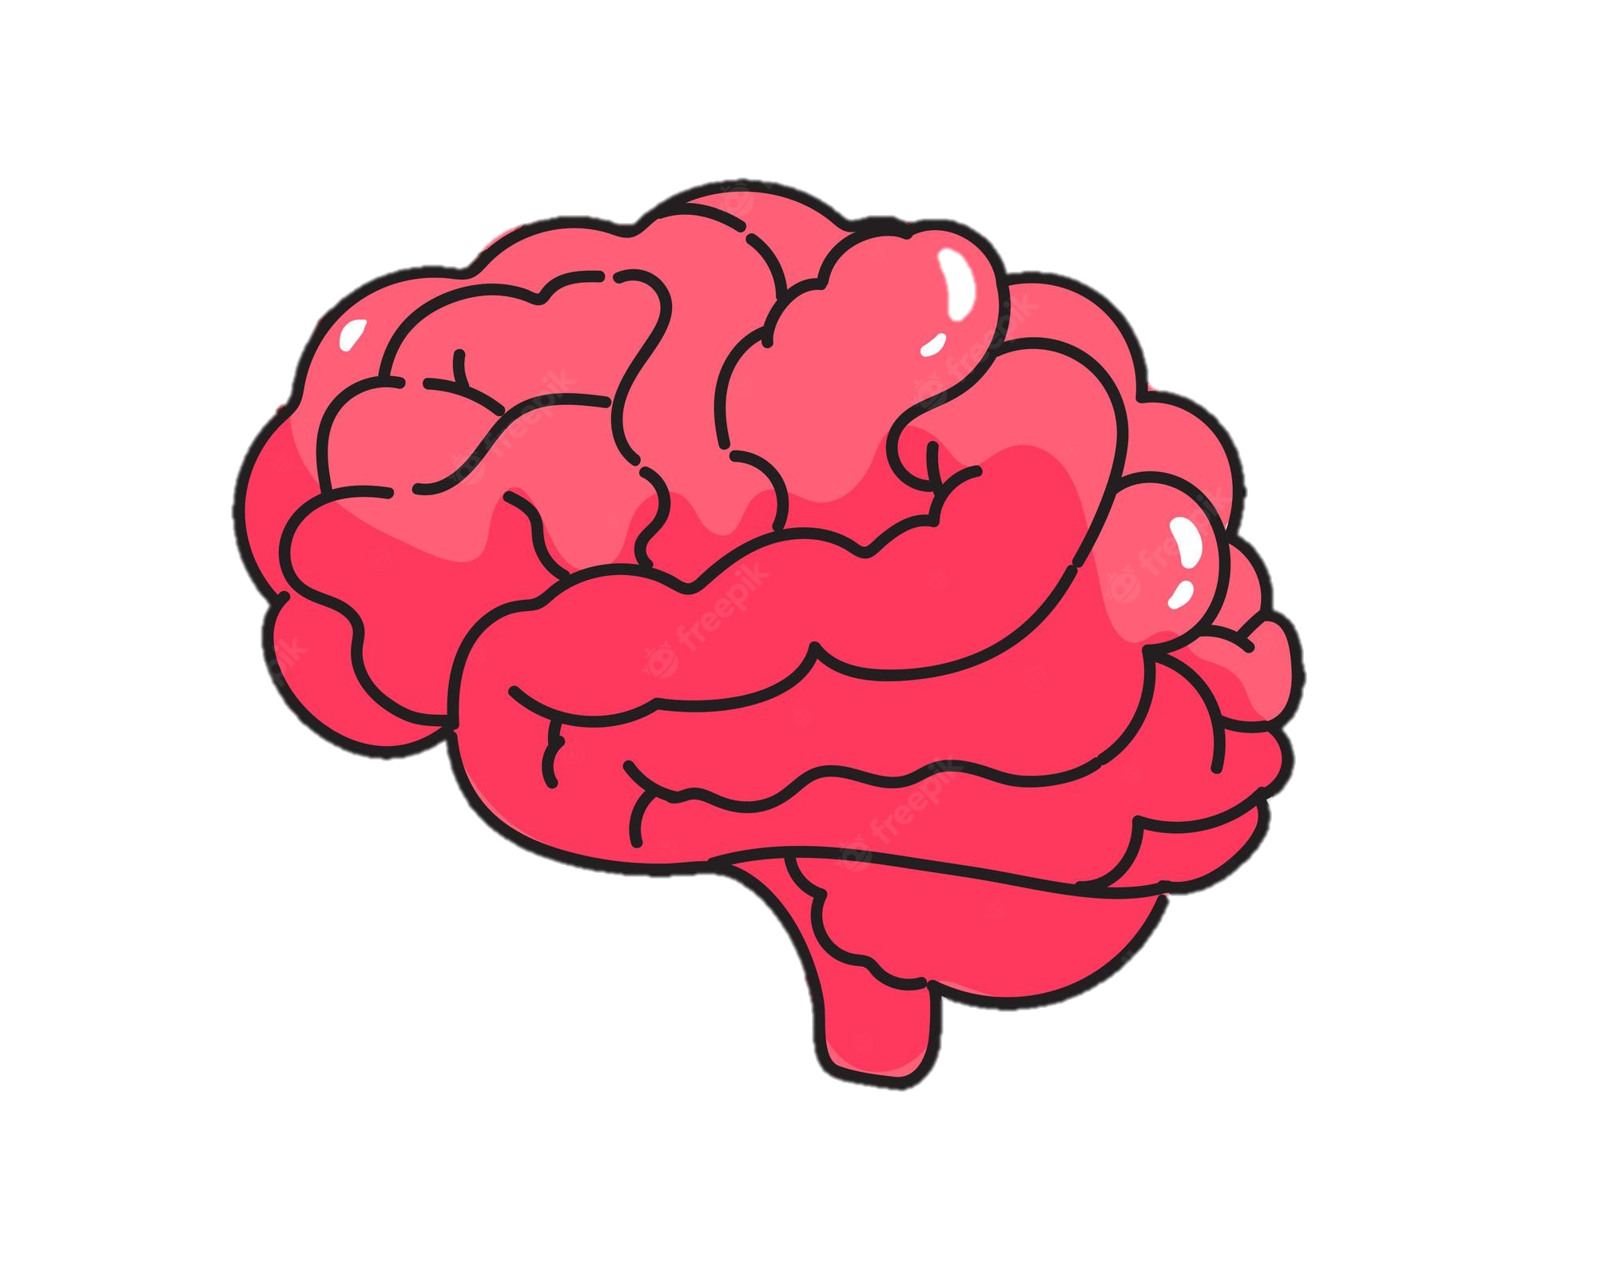
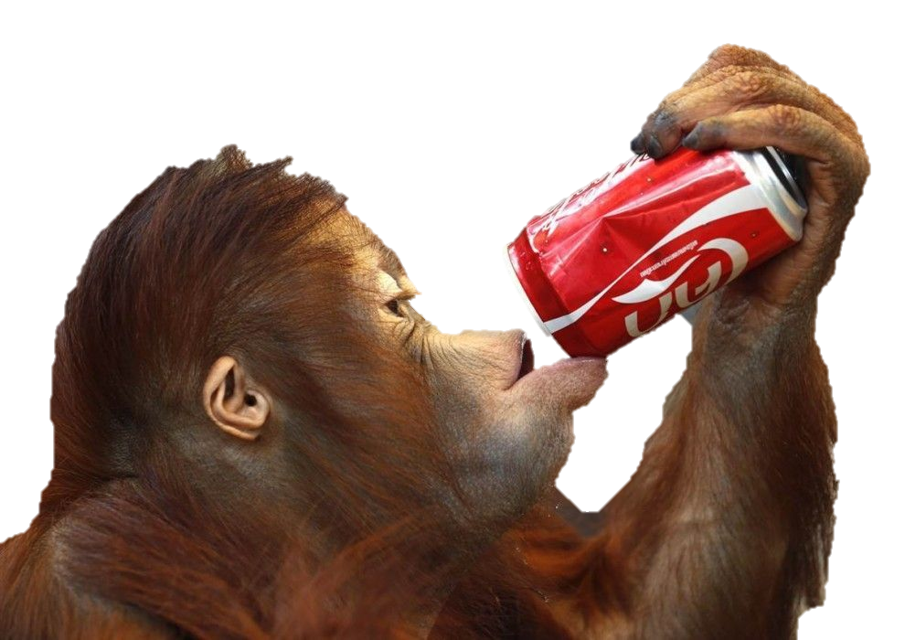

Un
conscious processing
Stimuli
Processing
Perceived
Affects Behavior
Notes:
In day to day we our brain receives a lot of information
He than processes it.
Some of is consciously perceived, and thus called conscious
And than it can, although doesn’t necessarily, affect our behavior.
But we don’t perceive everything we processes,
Some of the information doesn’t enter our awareness,
But can still affect our behavior (references)
This type of processing is called unconscious,
We know a stimuli is unconscious when someone can’t make any judgments regarding it.

Slide 4
Un
conscious processing
Stimuli
Processing
Perceived
Affects Behavior
Masking
Time
Notes:
To research in lab,
Need to render invisible,
Do so presenting it with close temporal proximity to more salient stimuli
This decreases visibility, but also decrease the neural response, → weaker behavioral change
How would one go about measuring the unconscious effect you ask? Well…

Slide 5
Measuring the Unconscious effect
Priming paradigm
Congruent
RADIO
RADIO
radio
Time
radio
Subjective Objective
Natural / Artificial
How well did you see the first stimuli?
On a scale of 1-4
RADIO / PHONE
1 2 3 4
Notes:
The most prominent method is the priming paradigm with a Keyboard RT measure.
A prime precedes the target, is rendered invisible, e.g. by masking with salient stimuli
Participant perform a task on the target, e.g. classify as artificial / natural.
To verify that prime is indeed invisible, two types of measures are available:
Subjective – participant asked about his experience of the prime.
Objective – participant is asked to perform a judgment about the prime, and the invisibility is inferred from low accuracy..
Prime,target can be either
congruent – evoke the same response

Slide 6
Measuring the Unconscious effect
Priming paradigm
Incongruent
Congruent
CLOUD
Time
radio
Natural / Artificial
Notes:
Or incongruent – evoke opposite responses

Slide 7
Measuring the Unconscious effect
Priming paradigm
Incongruent
Congruent
Congruency effect
CLOUD
RT
Time
radio
Natural / Artificial
Greenwald et al. (1996); Van den Bussche et al. (2009)
Notes:
We expect that if prime is processed, the RT would be longer in incongruent.
To Measure the effect we compare the RT between the conditions and that difference gives us the congruency effect.
It implies that the prime was unconsciously processed.
Problem is this effect is usually very small when recorded with a keyboard (add references)

Slide 8


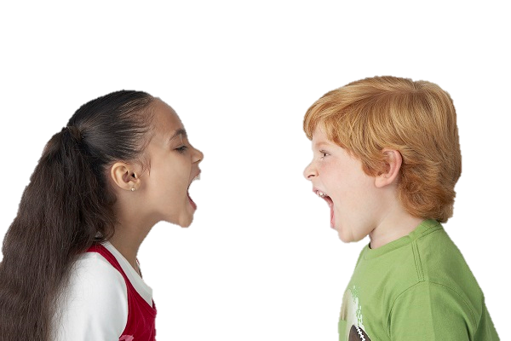
Consequences of Low Sensitivity
Problem: Small unconscious effects
Consequence: Contradicting findings
Cause? Underestimation of the effect
Solution: Increase sensitivity
Contradicting findings:
No
Unconscious processing!
Hesselmann & Knops (2014)
Kouider et al. (2009)
Moors et al. (2016)
Mudrik & Biderman (2017)
Peters & Lau (2015)
Unconscious processing!
Notes:
The problem with a small effect is that it is hard to detect,
Which leads to contradicting findings (references)
that in turn evoke controversy on the scope of UC processing. (references)
Some say:
Unconscious processing can perform high level functions and have a small but existing affect on behavior, (references)
Others say:
It is negligible, and the parts of it that can be found can be explained by conscious influence. (references)
One explanation that can account for the contradicting findings is methodological limitations that cause an underestimation of the UC effect
solution - more sensitive measure
Controversy:
(Desender & Van Den Bussche, 2012; Hesselmann & Moors, 2015; Michel, 2019; Peters et al., 2017; Peters & Lau, 2015)

Slide 9
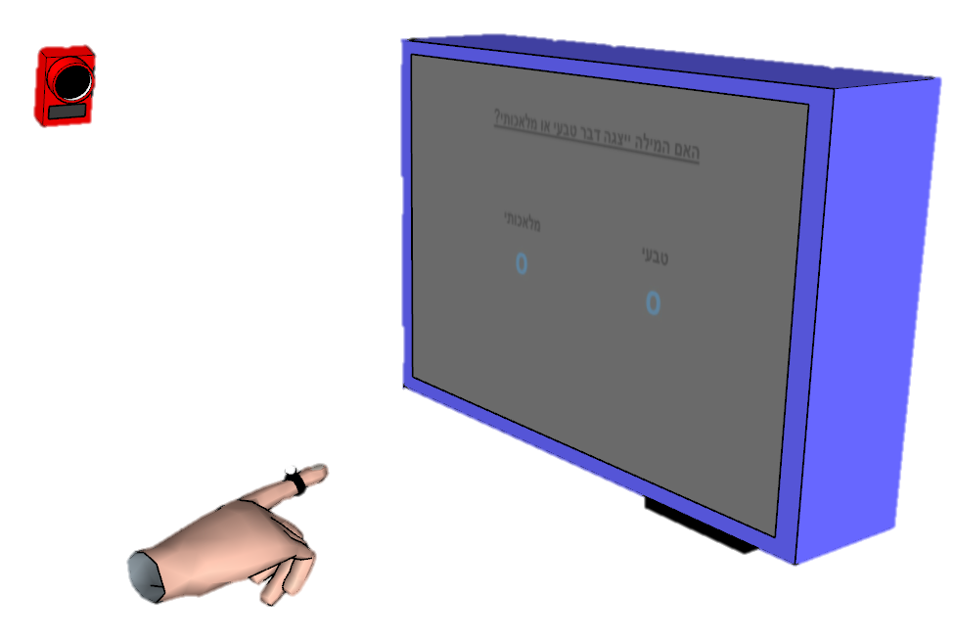
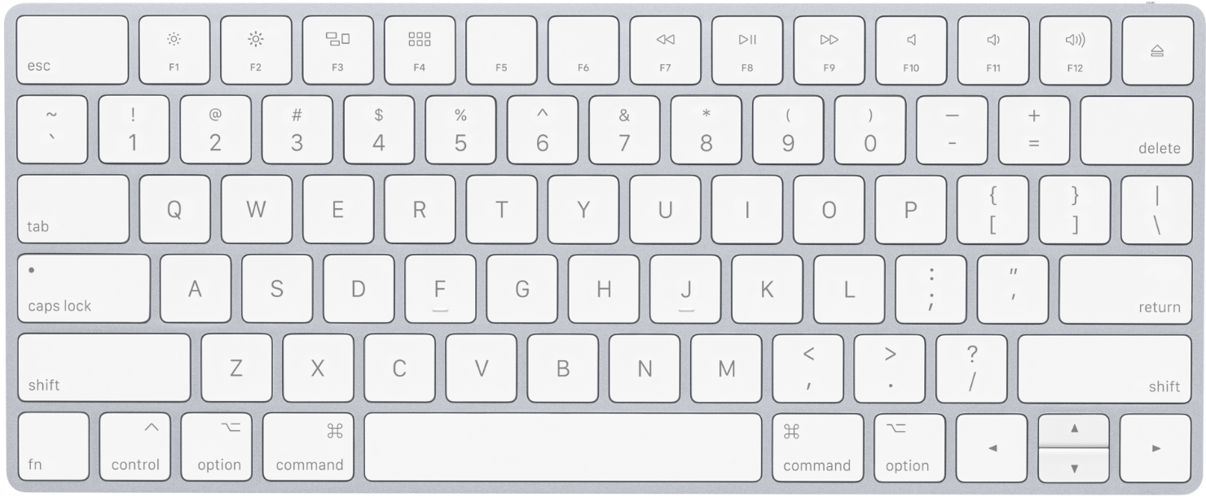
Keyboard Vs. Motion Tracking
Single value
Post decision
“Poor” – RT, accuracy
Continuous
Online
“Rich” – RT, onset, velocity…
Notes:
One option for improving sensitivity is to use motion tracking,
Which has become a popular tool for probing unconscious effects. (references)
This tool has three main advantages over the usual keyboard response measure:
(references)
Continuous – more suitable for ongoing cognitive processes
Rich – allows to capture effect which aren’t detectable in other parameters of the response.

Slide 10
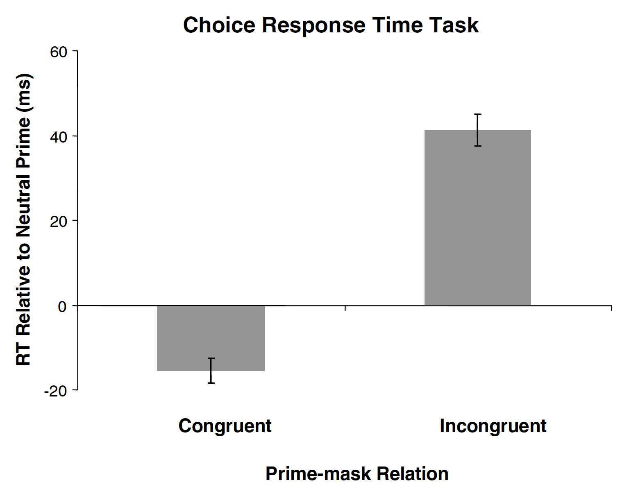
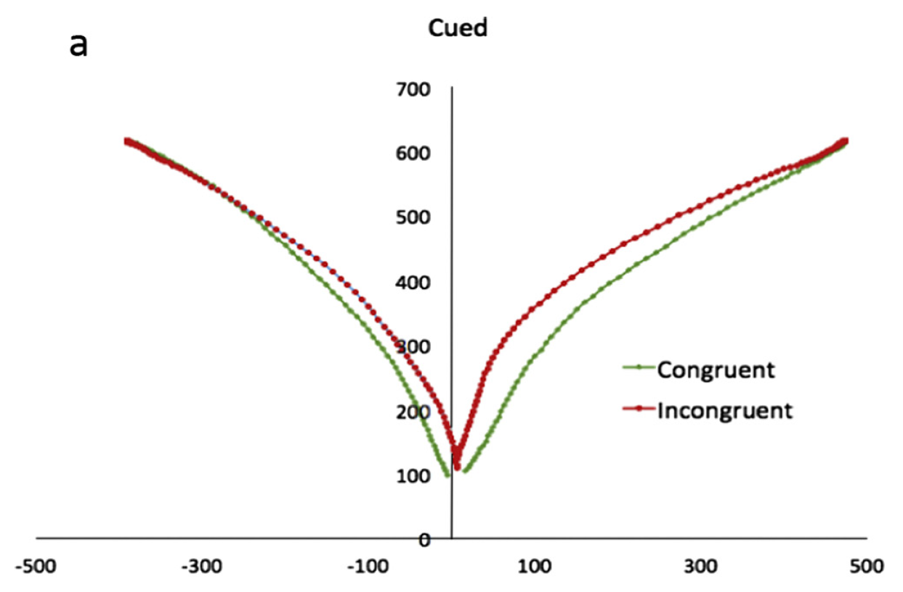
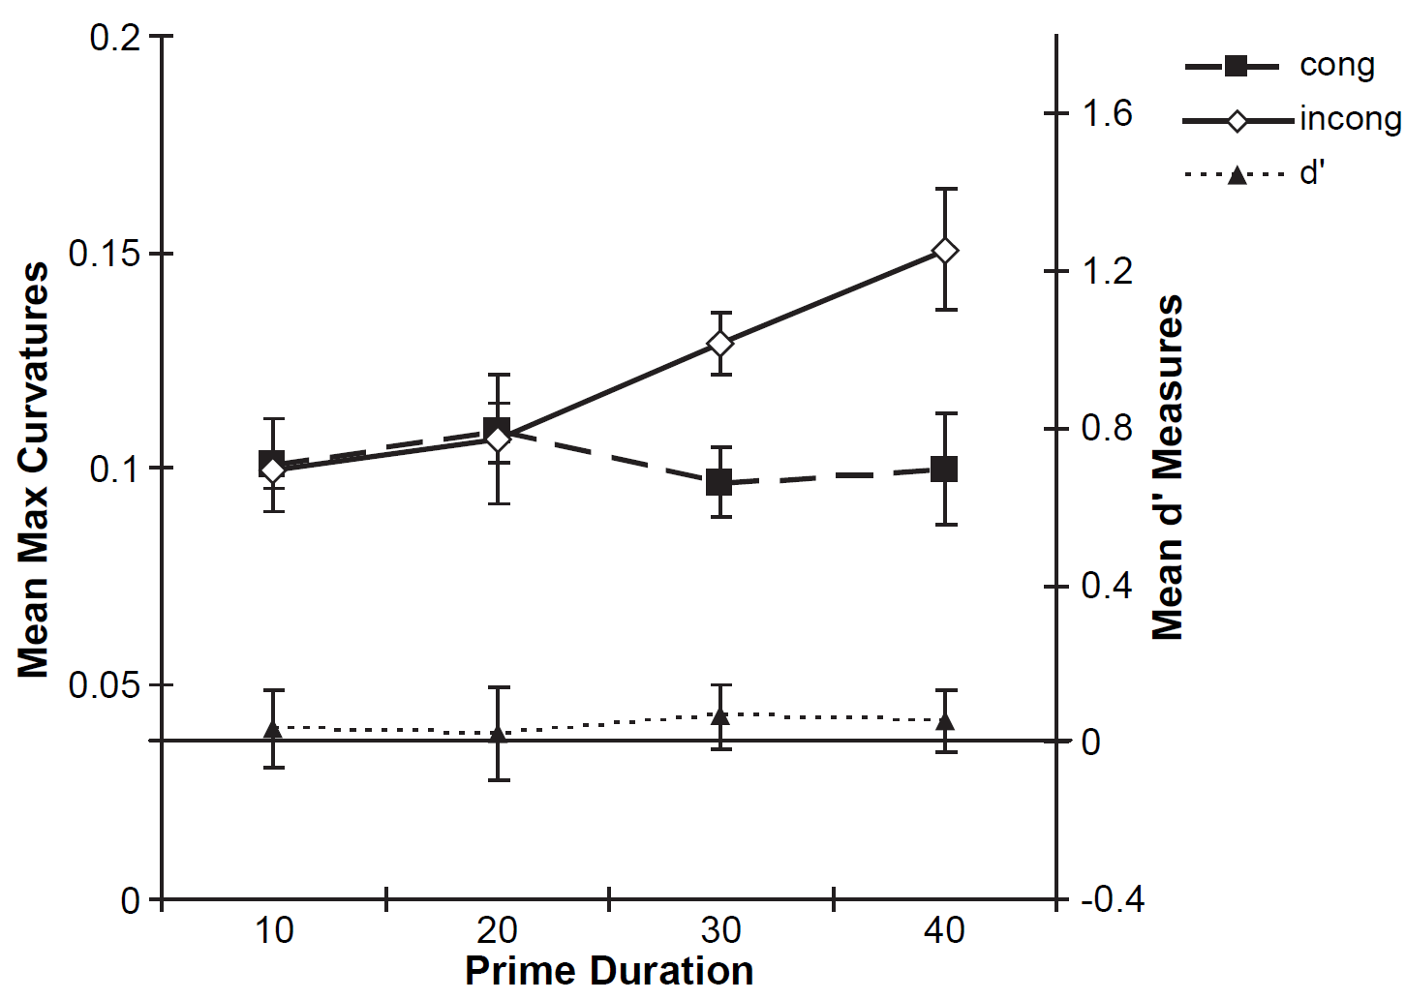
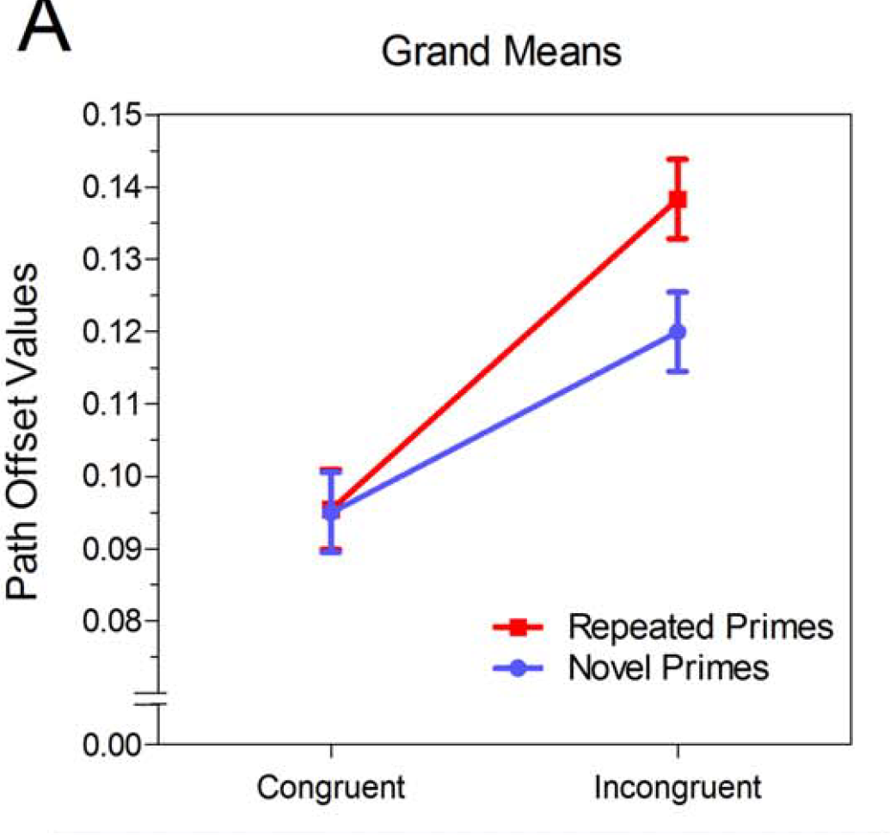
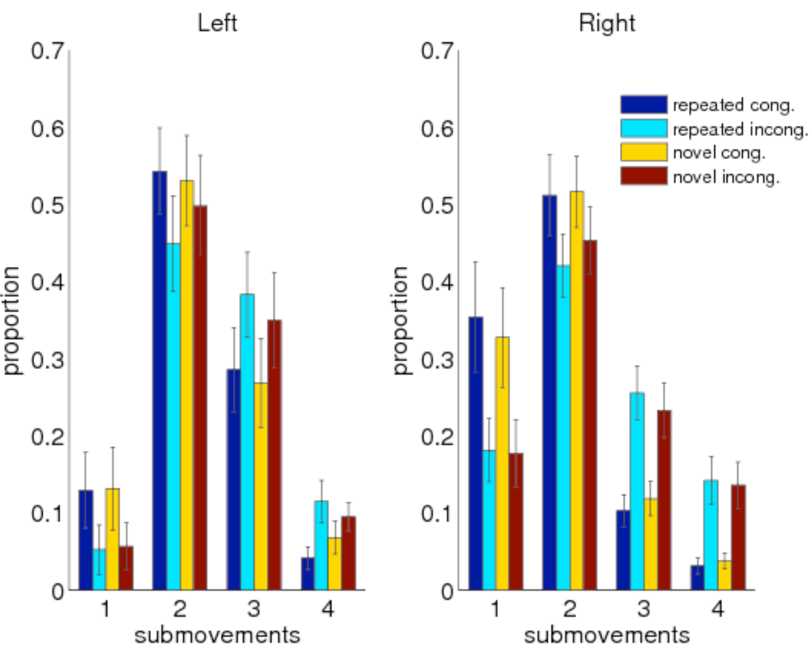
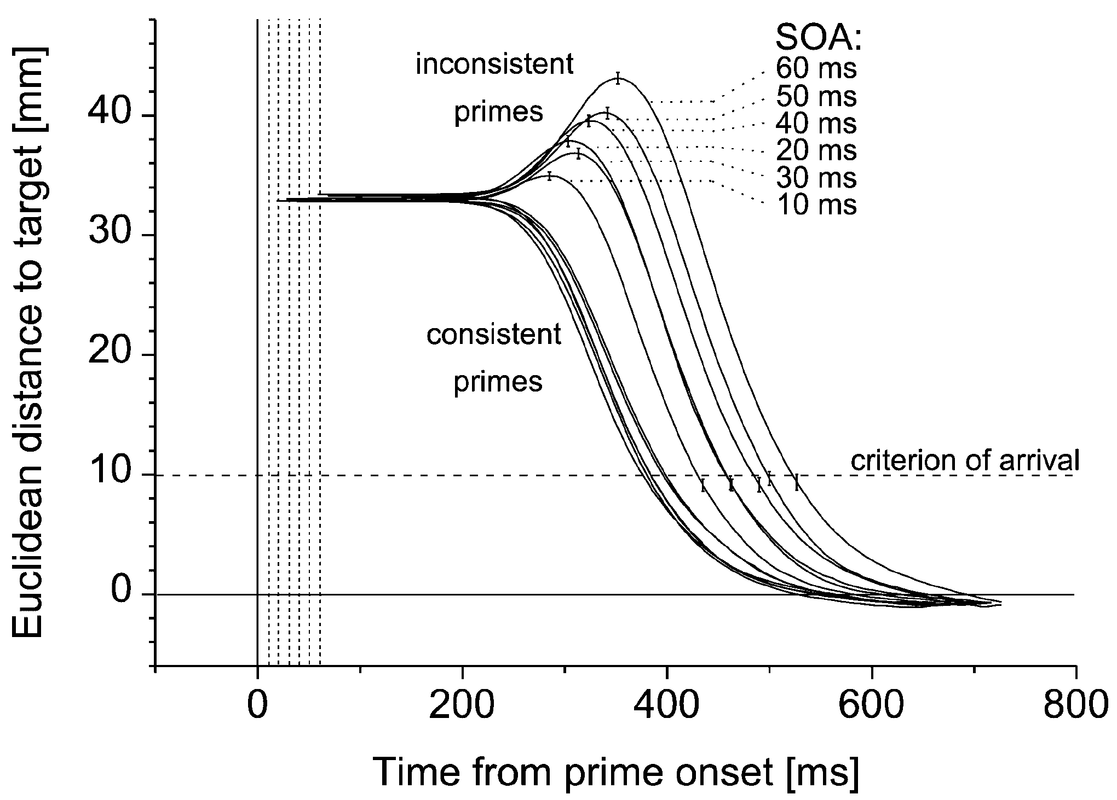
Motion Tracking’s Sensitivity to Unconscious Effects
Finkbeiner et al. (2008)
Cressman et al. (2007)
Xiao & Yamauchi (2015)
Congruent Incongruent
Congruent
Incongruent
Congruent
Incongruent
Finkbeiner & Friedman (2011)
Friedman & Finkbeiner (2010)
Schmidt (2002)
Congruent
Incongruent
Incongruent
Proportion
Congruent
Submovements
Time
Notes:
The usage of motion tracking for probing cognitive processes and specifically UC processing has been growing.
Several studies have shown that motion tracking can detect UC effect.
Question is, is motion tracking more sensitive than keyboard RT?

Slide 11
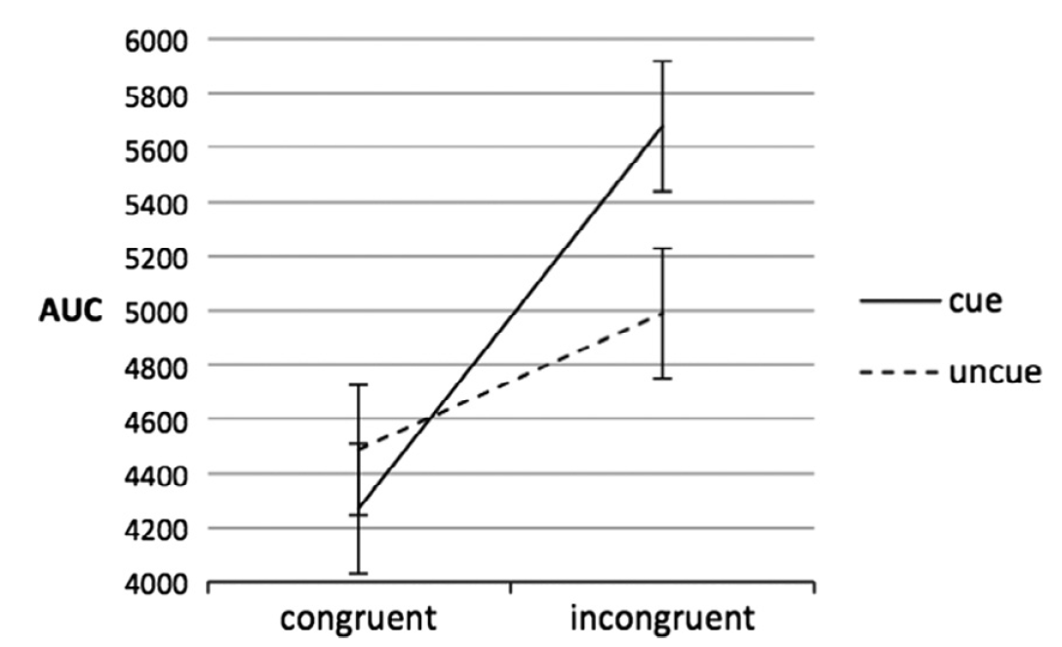
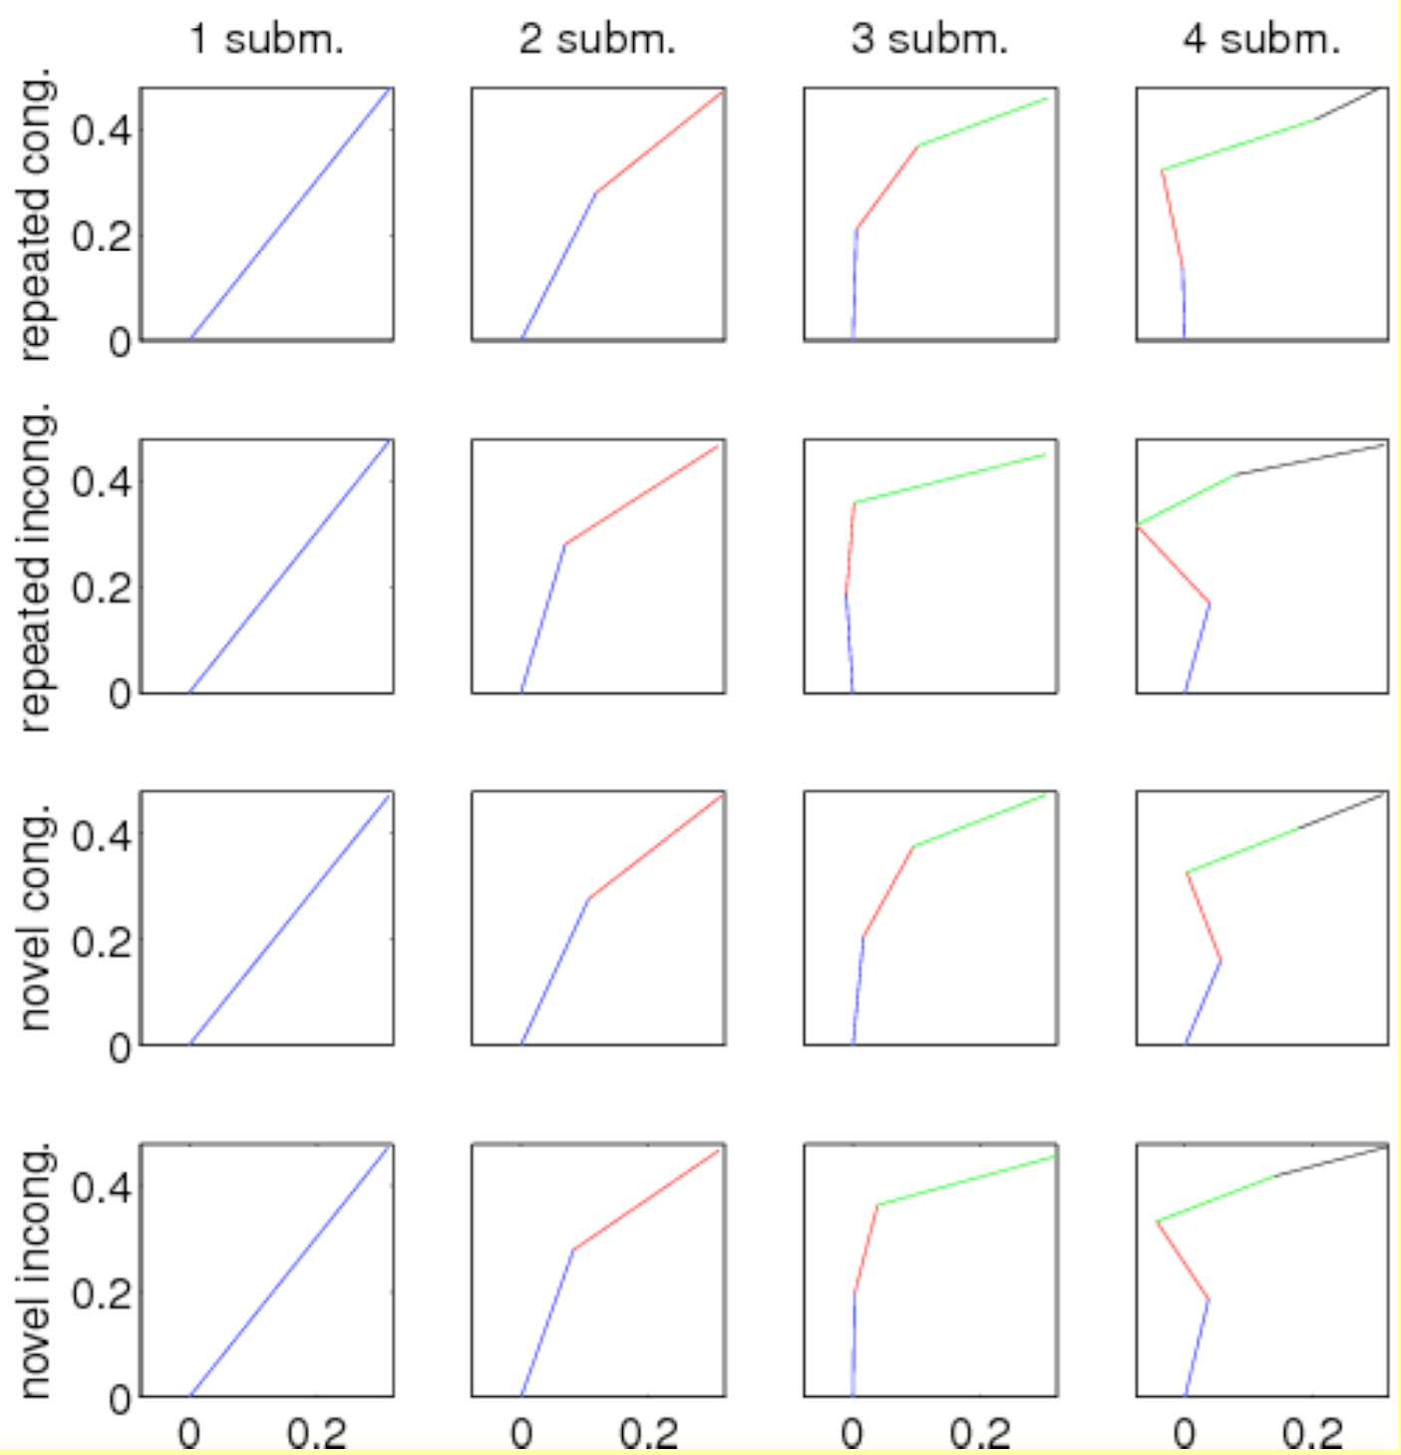
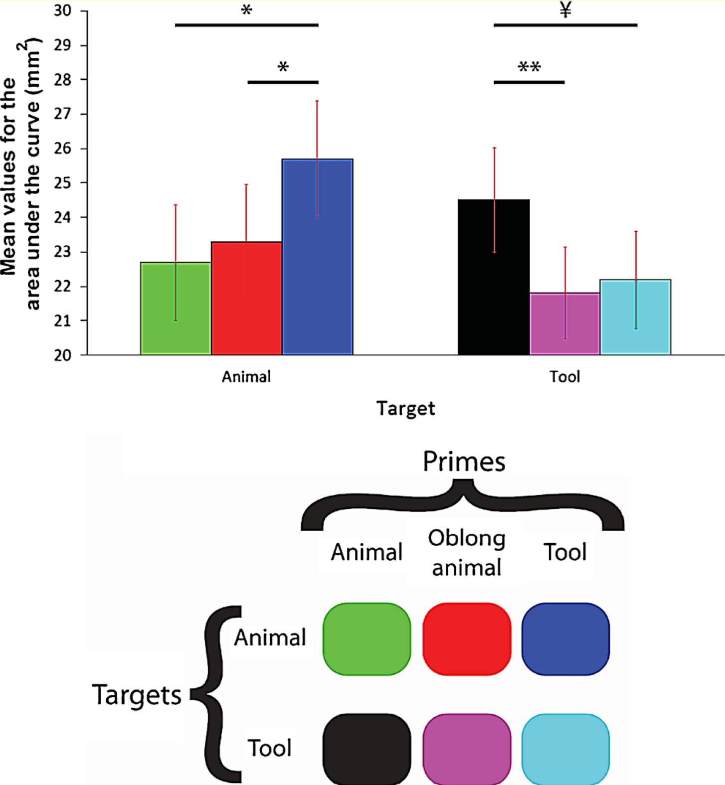
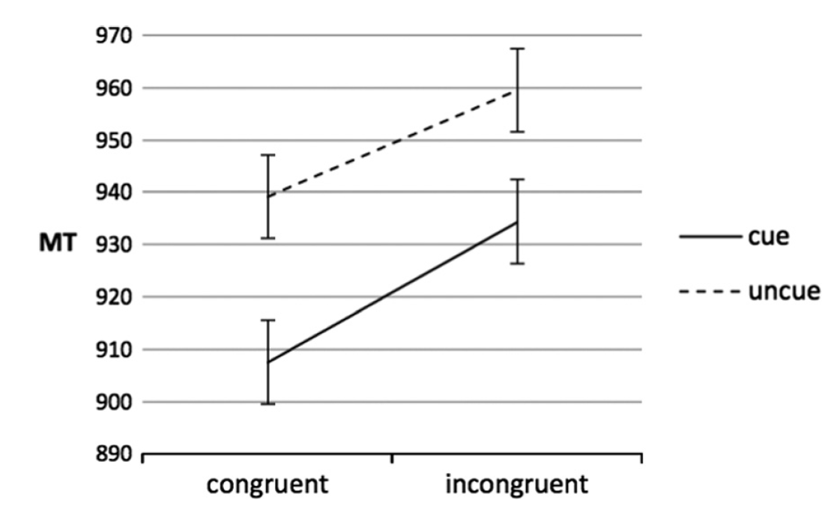
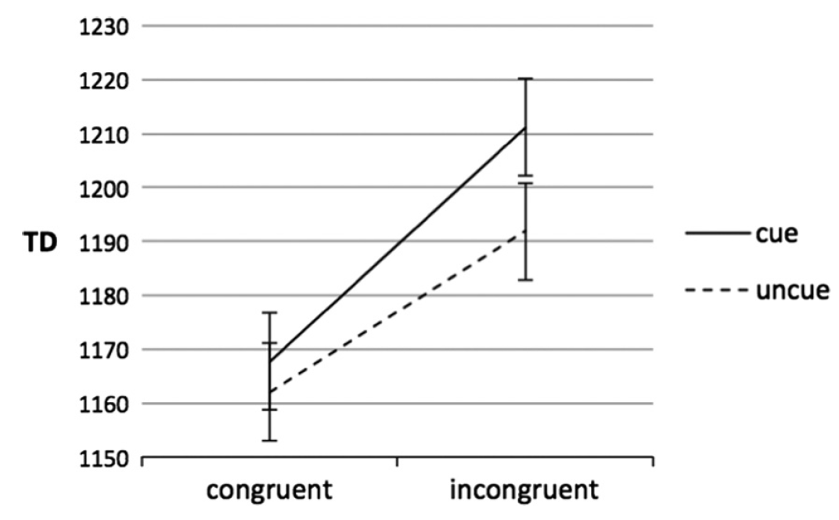
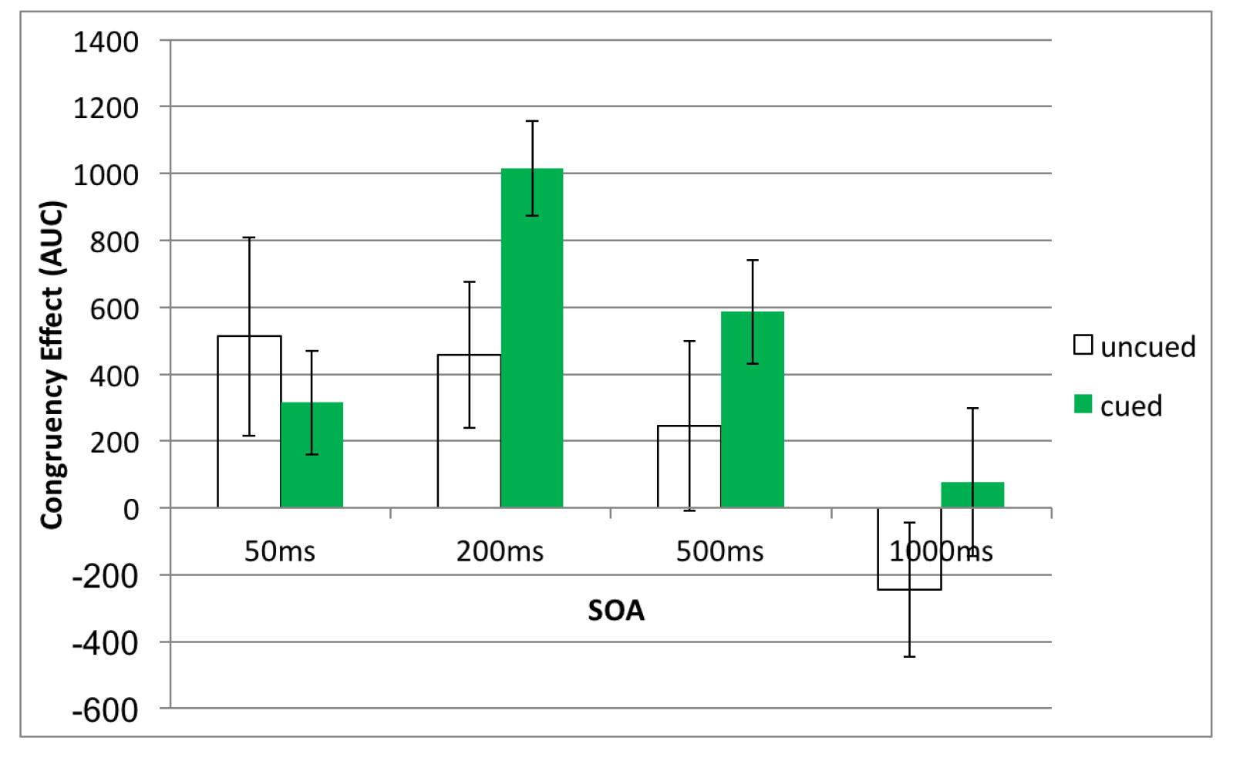
Motion Tracking’s Sensitivity to Unconscious Effects
Friedman & Finkbeiner (2010)
Temporal dynamics of masked – hard to understand congruency effect from graph.
On-line control fo poiting – shows congruency effect.
Subliminal semantic priming in near – shows priming effect. TD = trajectory distance
Grasping with the eyes – hard to understand graph
Flexibility of non consciously – shows priming nicely
Engaging the motor system – shows priming nicely
The role of attention – shows congruency cued vs un-cued.
The finger in flight – Shows congruency, but masking was inefficient.
Notes:
Only 1 paper compared motion tracking to keyboard,
Before discussing it, I’ll show motion tracking is sensitive to UC effects.

Slide 12
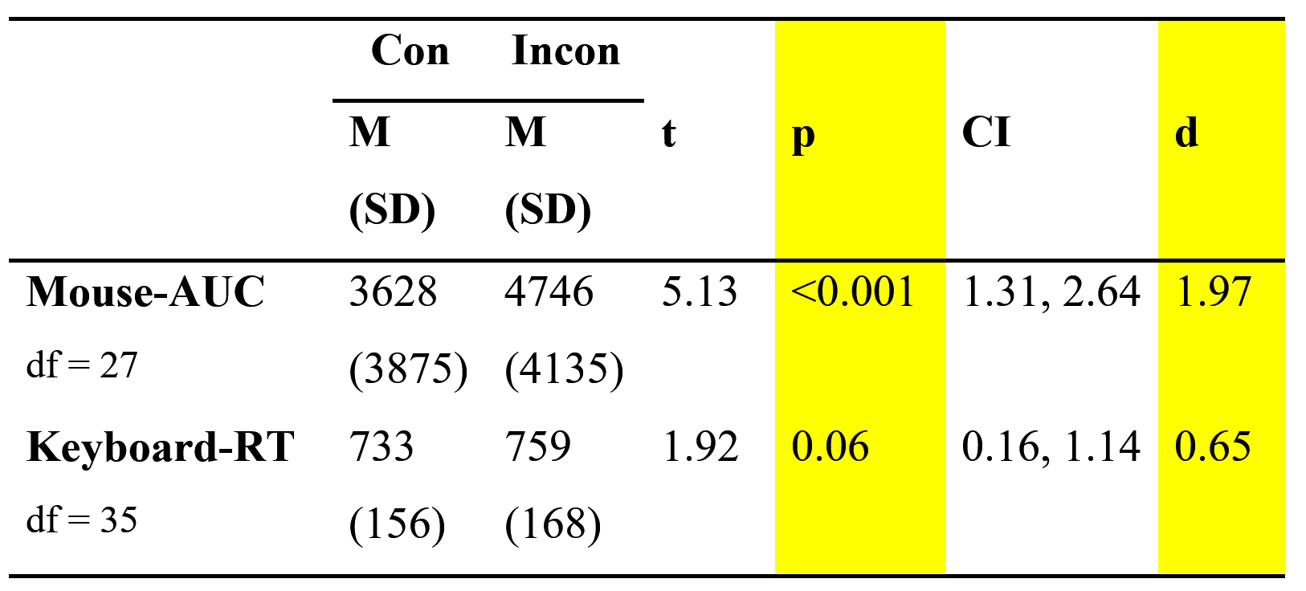
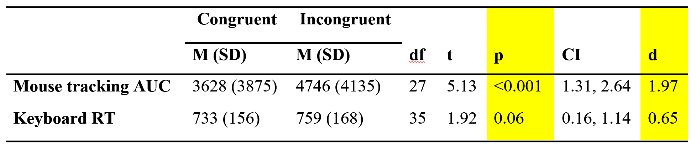
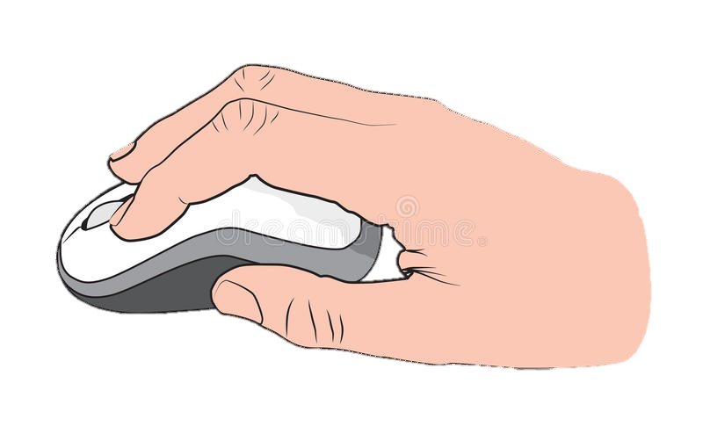
Xiao et al (2015)
Time
3 \ 3
Same / Different
VS
Notes:
To date,
Only one study directly compared them (reference)
Importantly, it found a robust weffect when using mouse tracking,
While the keyboard effect was only marginally significant.

Slide 13
Xiao et al (2015), Limitations
Mouse
4000
Limited awareness measure:
Low number of awareness assessment trials
Awareness assessment on separate block
Correlation underestimates awareness
Malejka et al. (2021)
d’ > 0
Congruency effect (AUC)
2000
0
Keyboard
400
200
Congruency effect (RT)
0
-200
0.0
0.4
0.8
d’
Notes:
96 trials isn’t enough to detect awarenesss according to work in our lab.
Estimating awareness in a separate block doesn’t allow to draw conclusions about awareness in single trial level.
To estimate awareness they estimated the correlation between the awareness score (d’) and the performance score (AUC/RT).
Since no correlation was found and the intercept at zero awareness shows a congruency effect larger than 0, they conclude UC processing occurred.
This analysis has been highly criticized since the correlation is limited by the reliability of each measure.
Therefor it understimates awareness.
d’ (sensitivity to prime) seems to be larger than 0.

Slide 14
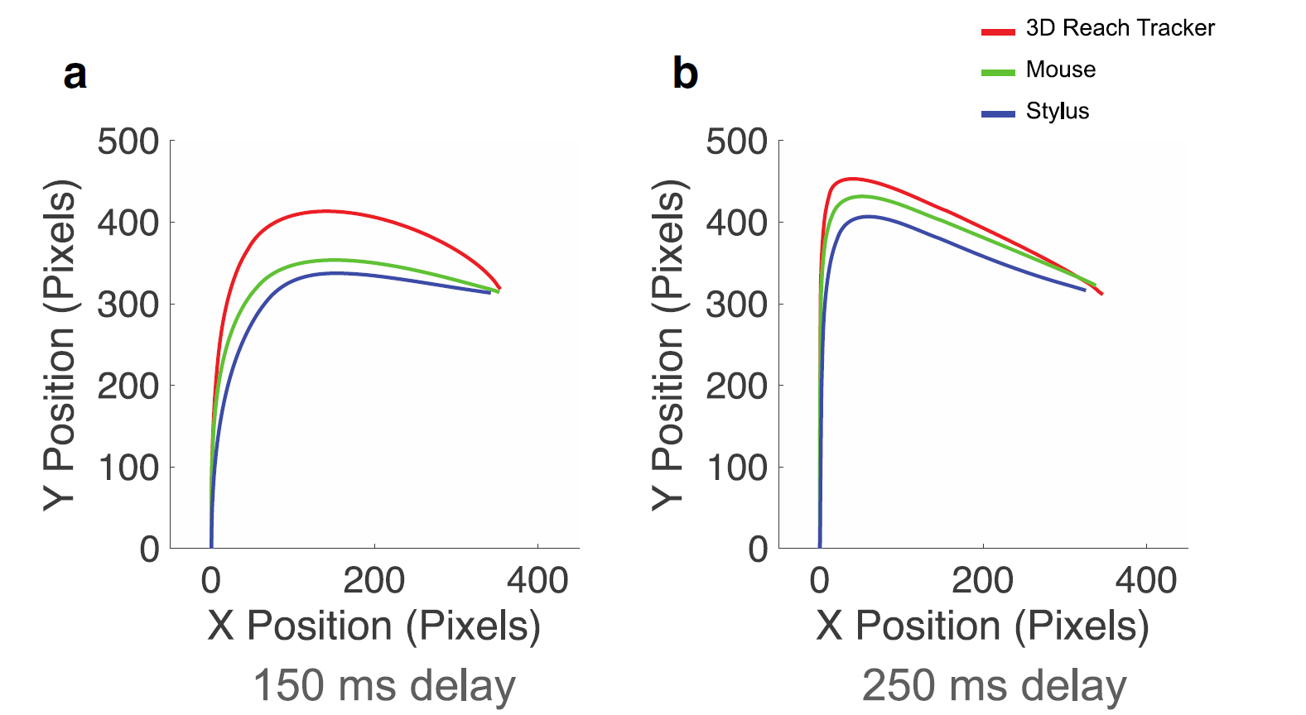
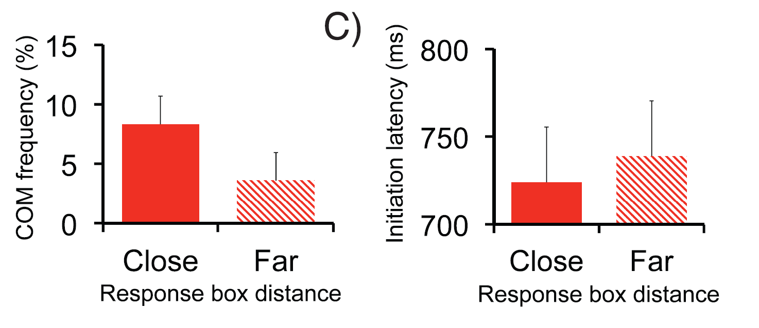
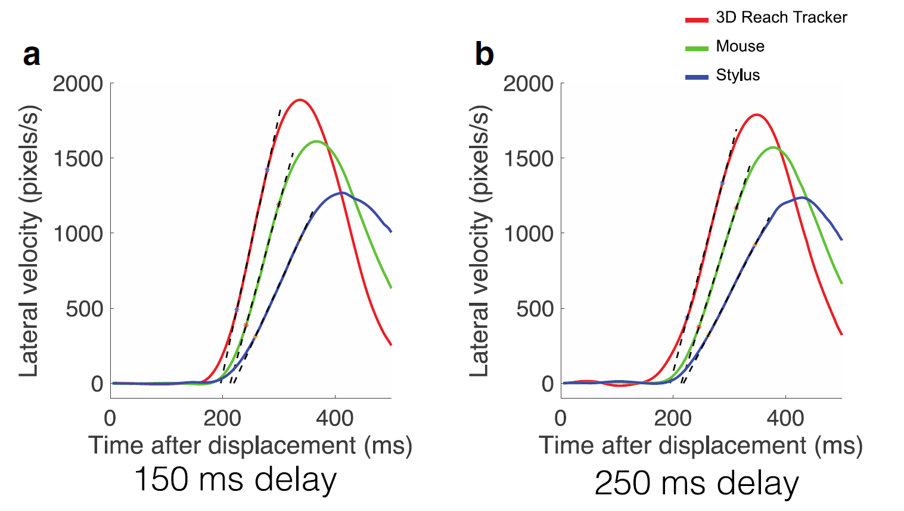
Xiao et al (2015), Limitations
Smaller curvature
Slower responses
Mouse tracking limitations:
Constrains movements
Desmurget et al. (1997)
Palluel-Germain et al. (2004)
Moher & Song (2019)
Less intuitive
More difficult
Less fluctuations in decision
Burk et al. (2014); Moher & Song (2014)
Lower velocity
Less COM
Notes:
Constrains movements - Mouse require remapping to 2D space, which might constrain movement, and thus affect the rrajectory and timing and prevent the effect from being expressed.
Less intuitive – therefor more effortfull and thus might be less likely to express fluctuations in decision (reference) which are important to us when looking for a congruency effect.
Are motor costs in mouse higher?
The movement itself is in 2D as opposed to 3D reaching, seems lower motor cost.
However planning is more costly since it requires remapping.

Slide 15
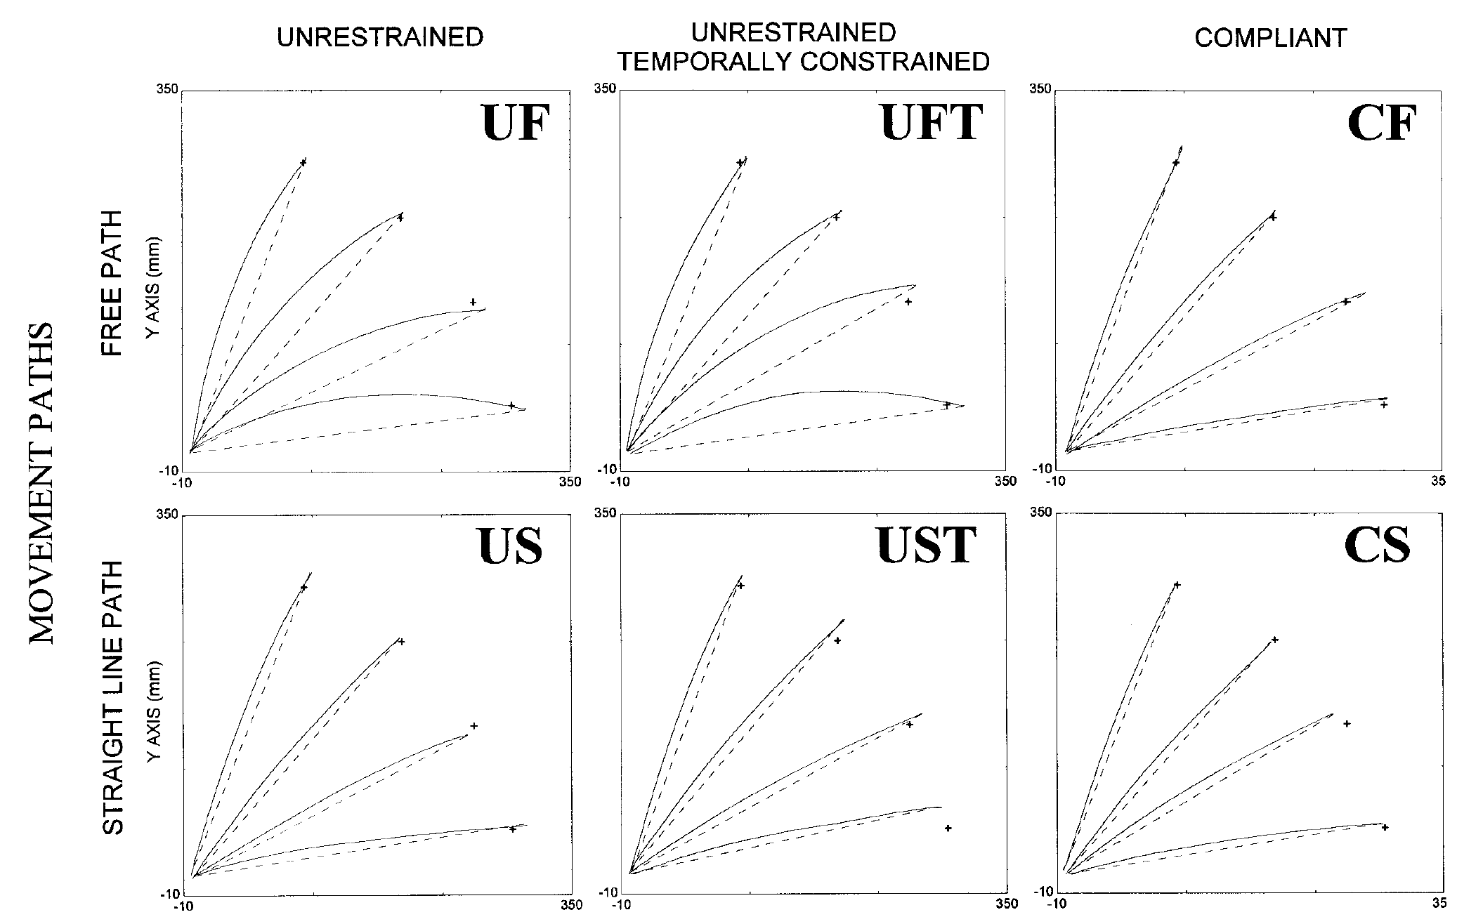
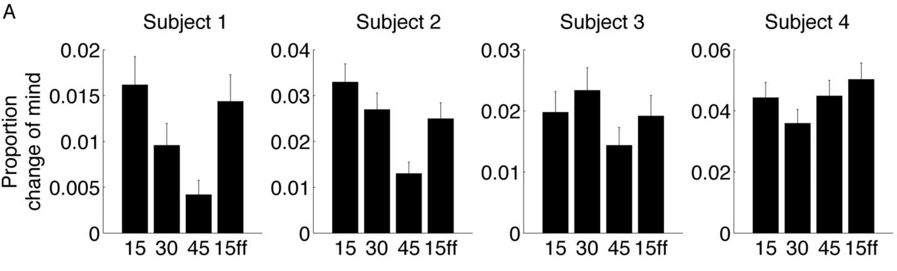
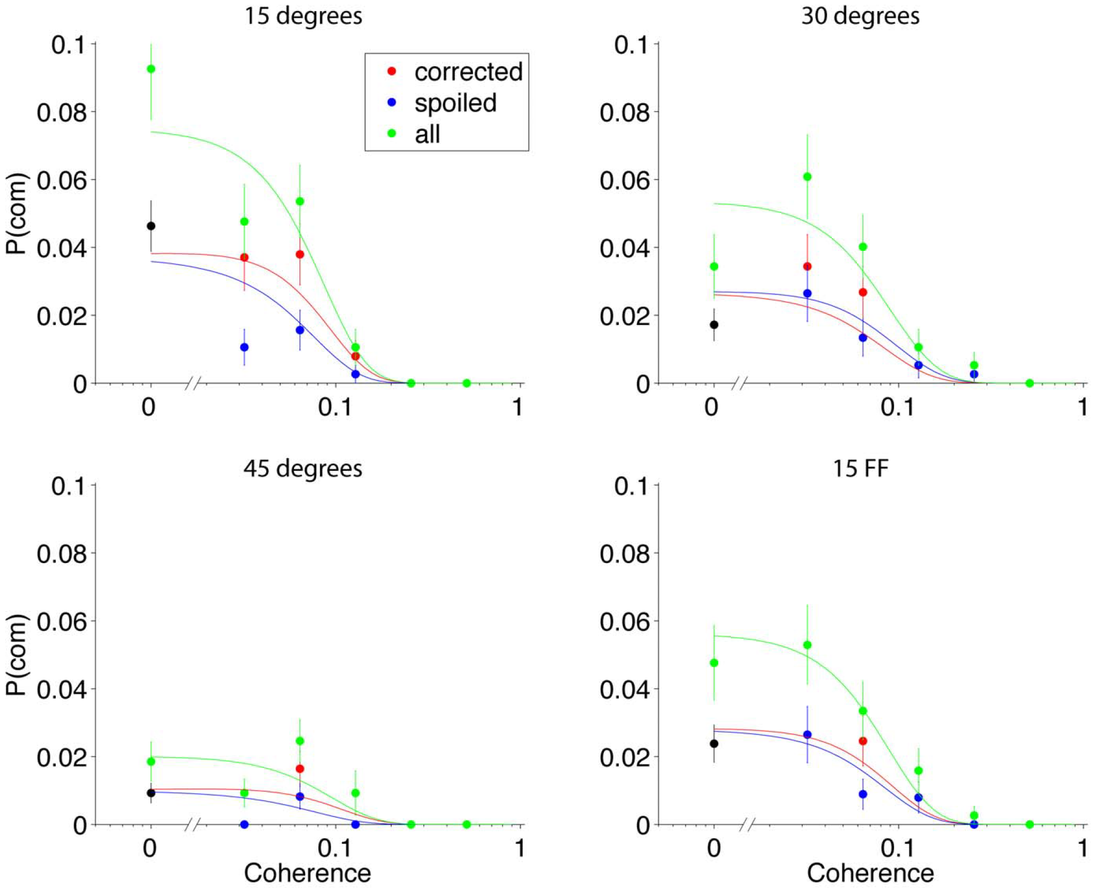
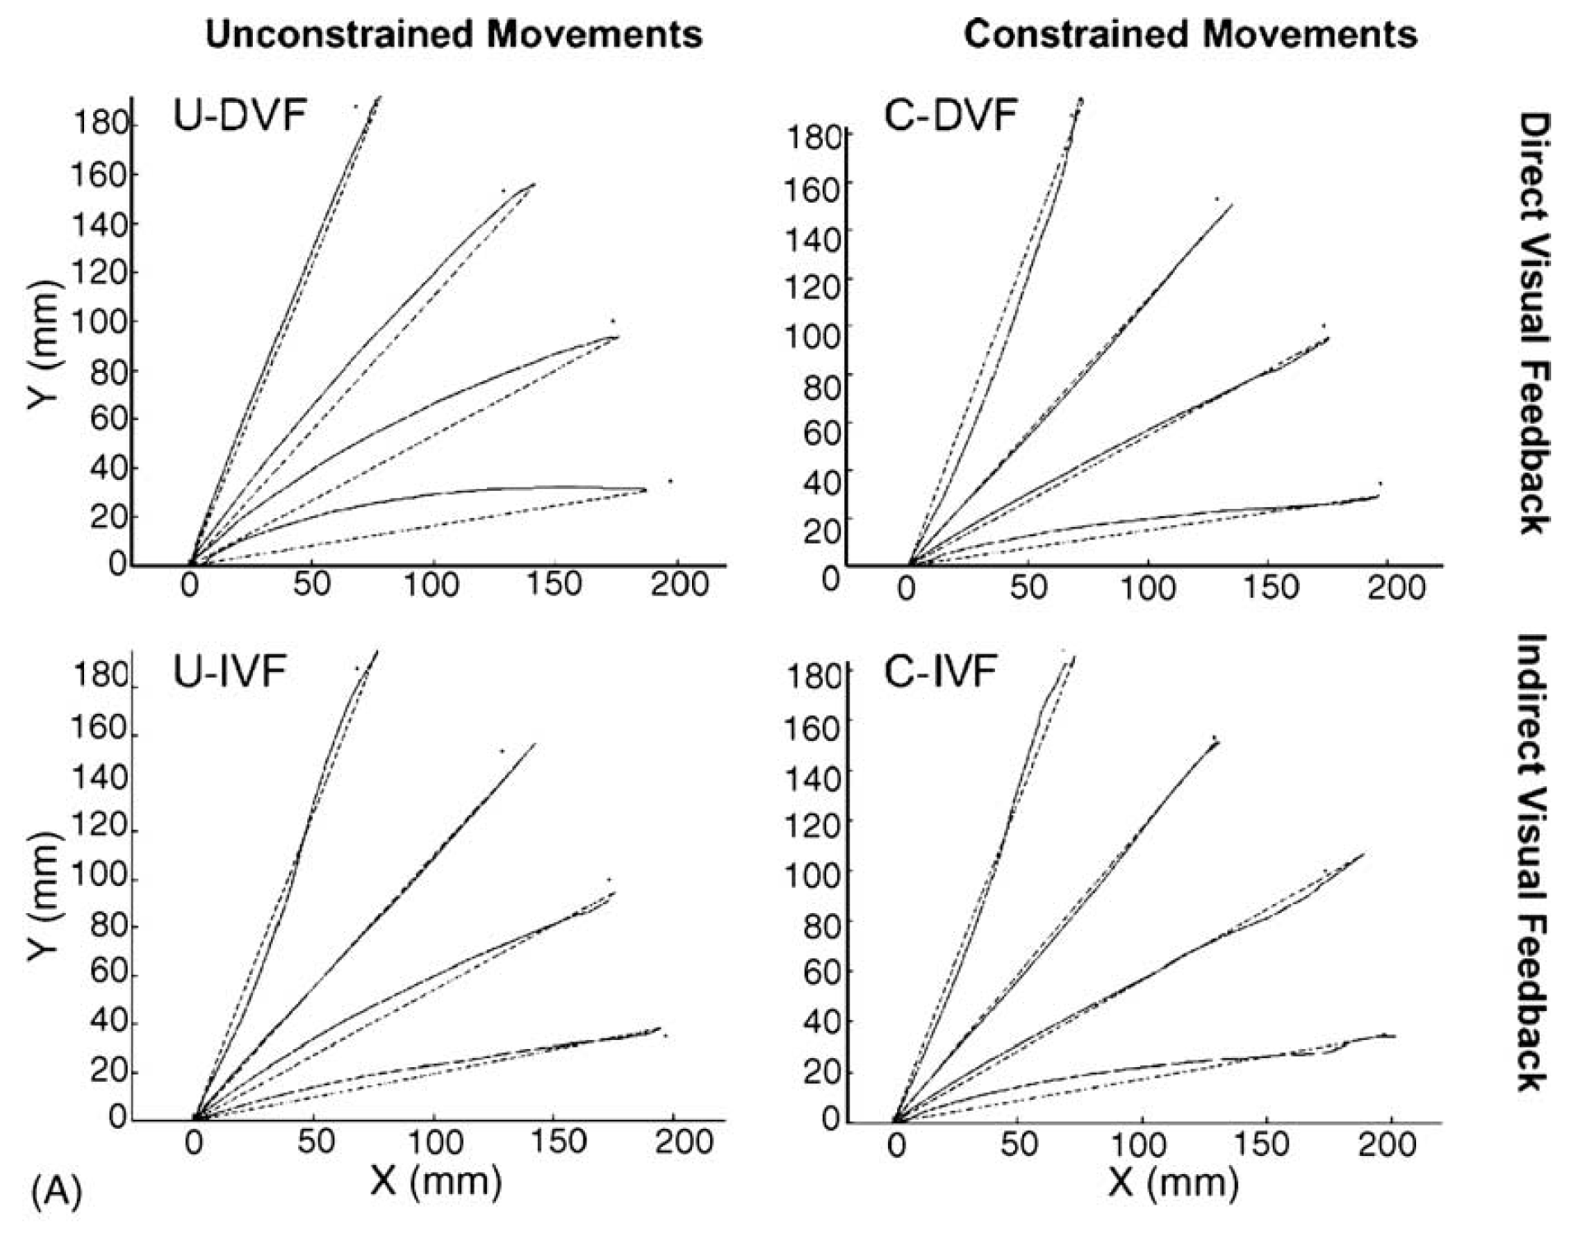
Mouse tracking Vs Reaching:
Constrains movements
Lower velocity
Longer movement duration
Slower responses
Smaller curvatures
Slower responses to COM
Desmurget et al. (1997)
Palluel-Germain et al. (2004)
Moher & Song (2019)
Less intuitive less fluctuations in decision
Burk et al. (2014); Moher & Song (2014)
Moher & Song (2019)
A comparison of simple – advantage for reaching.
Shorter movement duration, larger curve, Higher peak speed, shows earlier response to changes of GOAL.
Xiao et al (2015), Limitations
Smaller curvature
Lower velocity
Slower responses
Less COM
Desmurget et al. (1997)
Constrained and unconstrained – larger curve for reach and shorter latency and movement duration
Burk et al., 2014
Motor effort alters – COM are less common when degree between targets (cost of COM) is larger. Includes only 4 subs, this was found in 3 of them.
Moher & Song (2019)
Desmurget et al. (1997)
Palluel-Germain et al. (2004)
Moher & Song (2019)
Moher & Song (2014)
Desmurget et al. (1997)
Moher & Song (2019)
Moher & Song (2014)
Burk et al., 2014
Palluel-Germain et al. (2004)
Visual and motor constraints – larger curve in 3D reach than 2D reach, shorter movement time in 3D
Moher & Song, 2014
Perceptual decision processes – COM are less common when targets are far apart. Perhaps because evidence threshold is higher because cost is higher, therefore it takes more evidence to change the mind.
Response latency is slower when far apart, indicates waiting for more information before initiating movement.

Slide 16
Xiao et al (2015), Limitations
Mouse tracking Vs Reaching:
Constrains movements
Lower velocity
Longer movement duration
Smaller curvatures
Slower responses to COM
Desmurget et al. (1997)
Palluel-Germain et al. (2004)
Moher & Song (2019)
Less intuitive less fluctuations in decision
Burk et al. (2014); Moher & Song (2014)
Constrained and unconstrained – larger curve for reach and shorter latency and movement duration
Motor effort alters – COM are less common when degree between targets (cost of COM) is larger. Includes only 4 subs, this was found in 3 of them.
A comparison of simple – advantage for reaching.
Shows larger curve, shows earlier response,
What else? Check thesis.
Visual and motor constraints – larger curve in 3D reach than 2D reach, shorter movement time in 3D
Perceptual decision processes – COM are less common when targets are far apart. Perhaps because evidence threshold is higher because cost is higher, therefore it takes more evidence to change the mind.
Response latency is slower when far apart, indicates waiting for more information before initiating movement.

Slide 17
Xiao et al (2015) Current Study
Limited awareness measure:
Low number of awareness trials
Awareness on separate block
Correlation underestimates awareness
Malejka et al. (2021)
d’ > 0
Mouse tracking Vs Reaching:
Constrains movements
Lower velocity
Longer movement duration
Smaller curvatures
Slower responses to COM
Desmurget et al. (1997)
Palluel-Germain et al. (2004)
Moher & Song (2019)
Less intuitive less fluctuations in decision
Burk et al. (2014); Moher & Song (2014)
Rigorous awareness measures:
240 trials, for each measure
Estimate at single trial level
Subjective + Objective
Reaching movements:
Free movement
Intuitive
Notes:
To address all these issues,
In the current study I used a rigorous awareness measuring procedure.
240 awareness trails
Estimated at a single trials level,
And used both subjective and objective measures,
To make sure I can locate any residual awareness.
Additionally,
Reaching movements
Do constrain movement,
Is more intuitive

Slide 18
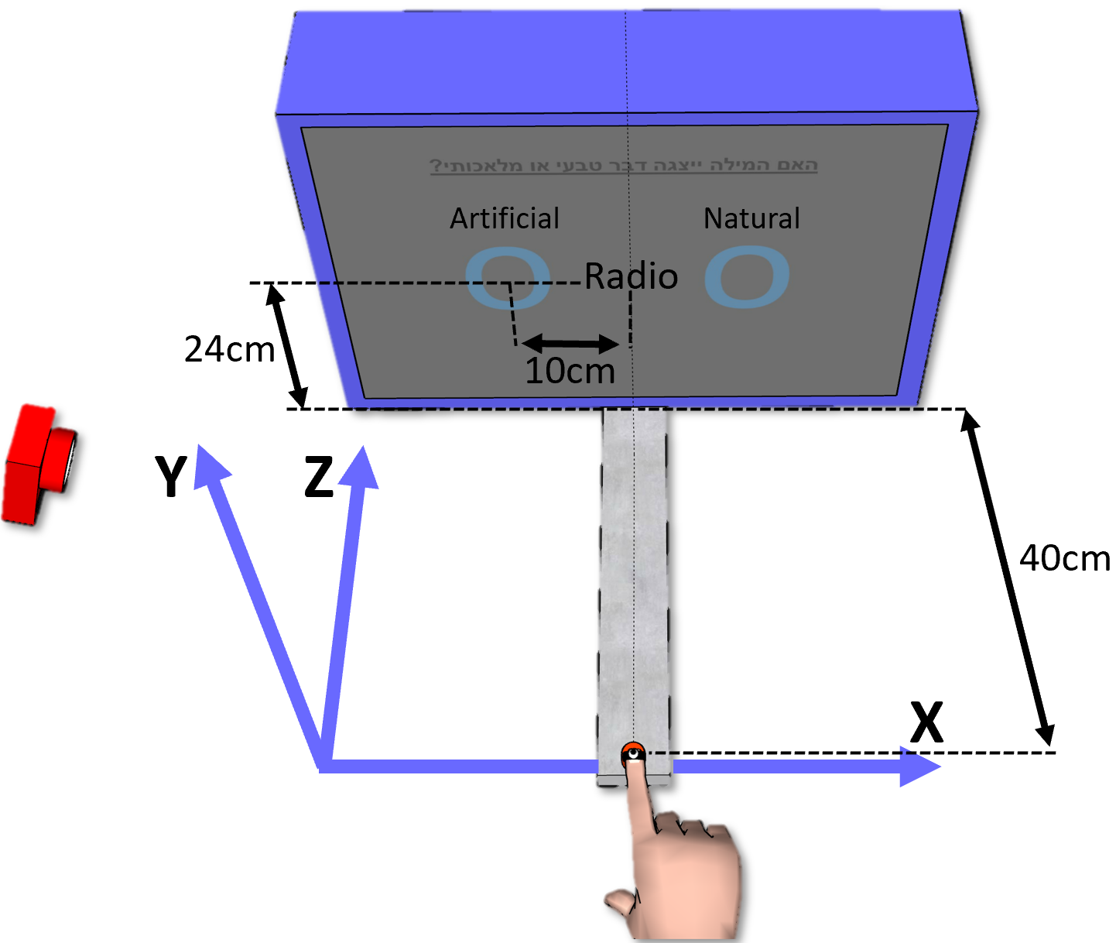

Setup
Track location using Motive
Six cameras
Transmit to PC with NatNet
Preprocessing with Matlab
Notes:
^{Wooden frame}

Slide 19
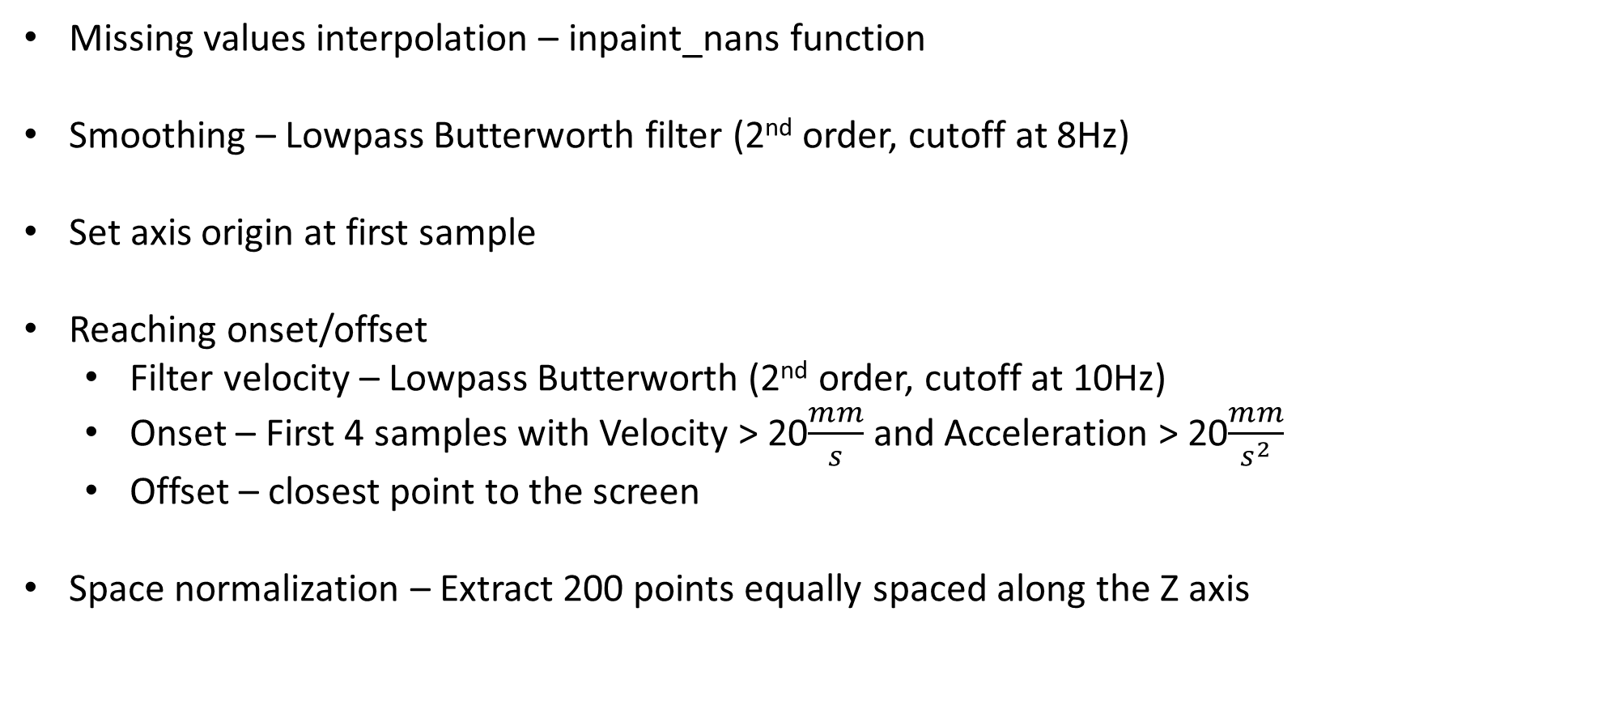
Preprocessing
Missing values interpolation – inpaint_nans function
Smoothing – Lowpass Butterworth filter (2nd order, cutoff at 8Hz)
Set axis origin at first sample
Reaching onset/offset
Filter velocity – Lowpass Butterworth (2nd order, cutoff at 10Hz)
Onset – First 4 samples with Velocity > 20$\frac{mm}{s}$ and Acceleration > 20$\frac{mm}{s^{2}}$
Offset – closest point to the screen
Space normalization – Extract 200 points equally spaced along the Z axis
Screen
Z
Gallivan & Chapman (2014)
X
Notes:
inpaint_nans - extrapolation – linear
Interpolation – I THINK: uses 2nd derivative and least squares, chooses value with minimal diff in derivative from surrounding point.
Created a GUI to examine the filling of missing parts – filled parts seem natural, they do not cause a sharp “break” in the traj.
Normalization – B-spline, 6th order, roughness panelty = 10⁻¹⁸ on the 4th derivative, spline at every data point.

Slide 20
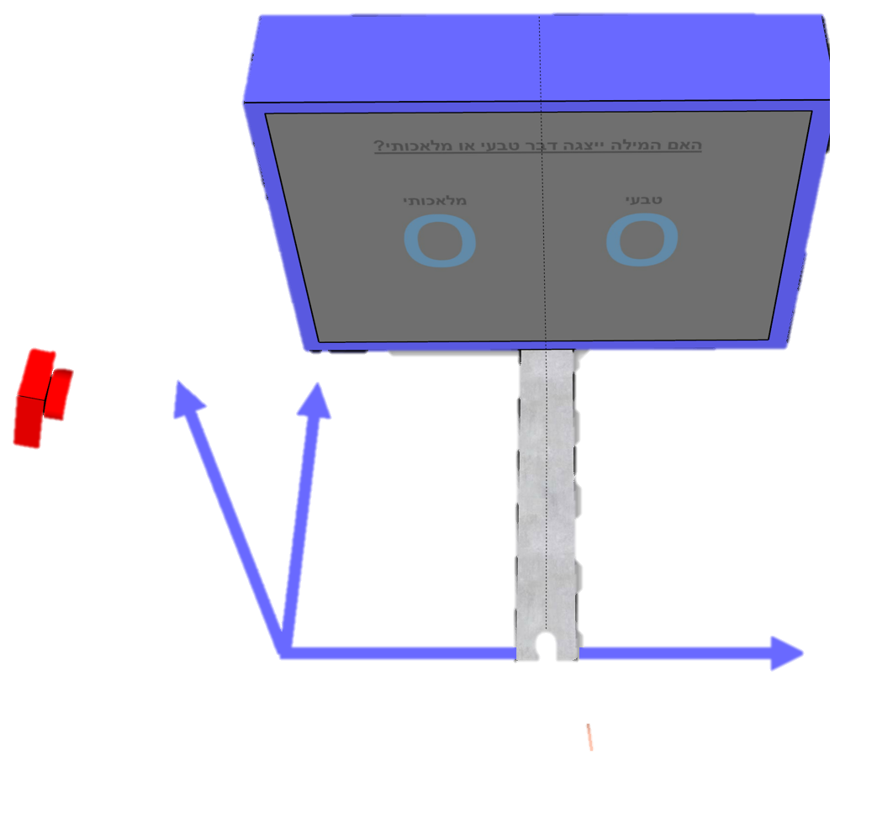
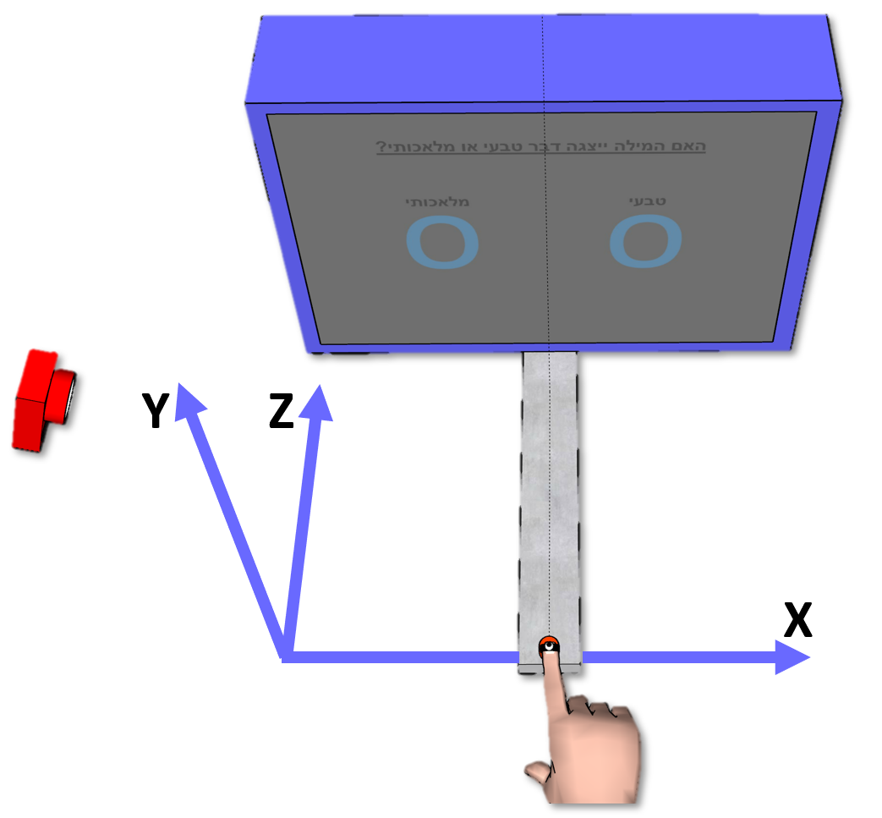
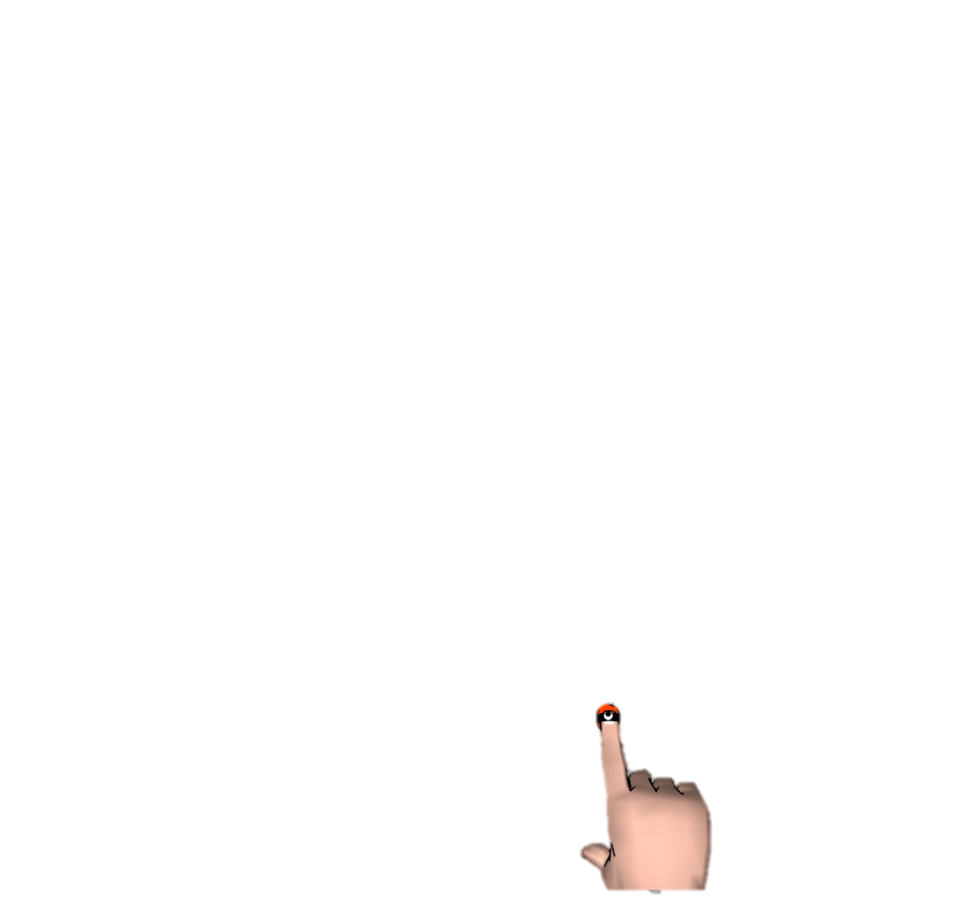
Current Study - Paradigm
Congruent - Same word
Incongruent - Different word
Different category
Congruency effect = Con - Incon
1000ms
270ms
30ms
Artificial Natural
RADIO
TREES
radio
30ms
Time
30ms
Artificial Natural
radio
0-1500ms
RADIO PHONE
How well did you see the first stimuli?
On a scale of 1-4
1 2 3 4
Notes:
The paradigm was a priming paradigm
Prime and target words are displayed
Participant asked to classify the target.
FC – afterwords he is asked to identify the priem between two options
PAS – rate visisbility
To capture responses we used motion tracking,
To select answer participant reach it.
Congruenct condition
Incongruenct condition,
Congruency effect reflected by diff between trajectories

Slide 21

Current Study - Measuring the effect
Reaction time Congruent = Incongruent
Movement duration Congruent < Incongruent
Artificial Natural
radio
Reach area
Traveled distance
Changes of Mind
Screen
Screen
Screen
Reach Area
% Path Traveled
% Path Traveled
% Path Traveled
X
X
X

Slide 22
Current study
Pilot Experiment 1
Reaching
Pilot Experiment 2
Reaching
Exploratory
Confirmatory
Pilot Experiment 3
Reaching
Experiment 4
Reaching + Keyboard
Notes:
Three studies aimed at finding the optimal conditions for detecting an UC effect with motion tracking.
Fourth confirmatory study, that compares between motion tracking and keyboard response.

Slide 23
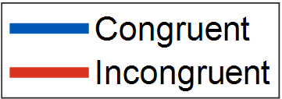
Pilot Experiment 1
Practice
1 block, with prime
Test
12 blocks, with prime
N = 10
Notes:
First study included 10 participants.
Explain about Graph.
No difference was observed between the con incon trajs
Trend in reach area
Explain about graph
The reason: Long RT.

Slide 24
Pilot Experiment 1
p = 0.169
p = 0.896
p = 0.169
p = 0.695
p = 0.896
Long response time (1.5sec)
Decision made before movement
N = 10
Notes:
First study included 10 participants.
Explain about Graph.
No difference was observed between the con incon trajs
Trend in reach area
Explain about graph
The reason: Long RT.

Slide 25
Evidence Accumulation
Artificial Natural
TREES
radio
Time
Notes:
To illustrate why long RT might be a problem, I will use an evidence accumulation model

Slide 26
Evidence Accumulation
Artificial Natural
Long response time
TREES
radio
Artificial
Evidence
Natural
Time
Notes:
The way evidence accumulation works,
Once stimulus is displayed, evidence accumulates in favor of the response that matches that stimulus.
Once it reaches threshold
Decision is made

Slide 27
Evidence Accumulation
Artificial Natural
Long response time
TREES
radio
Reaching
Artificial
Evidence
Natural
Time
Decision
RT Limit
1500ms
Notes:
If the sub reaches decision before movement,
The evidence accumulated in favor of the prime won’t affect the movement.
What about Cressman et al., 2007? Subs correct pre-planned movemnt after initiating it.
Yes, but the conflicting information is given during the movement,
While here it is given before the movement.

Slide 28
Evidence Accumulation
Artificial Natural
Long response time
TREES
radio
Reaching
Artificial
Evidence
Natural
Time
Decision
RT Limit
750ms
Notes:
Participnat will intiate movement earlier,
Since in this point in time evidence is in favor of the prime,
We might see its effect on the movement.

Slide 29
Pilot Experiment 2
Shorter RT Limit –
Reation time < 330ms
Movement duration < 430ms
Added practice to improve RT
Practice
1 block, w/o prime
Practice
1 block, with prime
Test
12 blocks, with prime
N = 9
Notes:
Shortenend RT
Added practice
Ran on 9 participants
Although results were not significant
We did observe some trends in the data

Slide 30
Pilot Experiment 2
Deviant participant
Many excluded trials (44.5%) low SNR
p = 0.273
p = 0.316
p = 0.699
p = 0.342
p = 0.781
N = 9
Notes:
Two explanations why no significance:
Deviante participant – w/o results are significant
Many excluded trials – Demandin faster responses resulted in more trials excluded due to bad timing.

Slide 31
Pilot Experiment 2, w/o deviant

Slide 32
Pilot Experiment 3
Practice day – improve RT
Practice
6 blocks, w/o prime
Day 1
Day 2
Practice
1 block, w/o prime
Practice
1 block, with prime
Test
12 blocks, with prime
N = 7
Notes:
Added practice day
Results yielded a prominent difference between the trajectoriesin,
As expressed in smaller reach area in incongruenct condition,
Mean movement in incongruent is biased to incorrect answer
But none survived multiple comparisons correction.

Slide 33
Pilot Experiment 3
p = 0.067
p = 0.052
p = 0.023
p = 0.010
p = 0.959
N = 7
Notes:
Added practice day
Results yielded a prominent difference between the trajectoriesin,
As expressed in smaller reach area in incongruenct condition,
Mean movement in incongruent is biased to incorrect answer
But none survived multiple comparisons correction.

Slide 34
Pilot Experiment 3
Marginal reduction in RT More excluded trials
than Experiment 2
p = 0.111
p = 0.082
N = 7
Notes:
Suprisingly, the reduction in RT was only mariginal,
Moreover, the number of excluded trials seems to increase.
Why? – overtraining? Respond too quickly. Num of early responses and short trajs increased.

Slide 35
Pilot Experiment 3

Slide 36
Experiment 4
Keyboard session, Reaching session
Practice
1 block, with prime
94%
Keyboard
6 blocks, with prime
Practice
1 block, with prime
24%
Reaching
6 blocks, with prime
N = 30
Notes:
Pre-reg
30 participants
2 Separate sessions, one for keyboard, one for reaching,
Order counterbalanced.
Each session included 240 trials,
Estimated to give an effect according to the results of exp 3 + 2.
A bias towards the incorrect answer was found in incongruent trials.
Grey – Permutation& clustering analysis, these differences significant.
evident thorught almost entire trajectory (24-94%, 175-390ms)
The congruency effect was also expressed in the extracted variables.

Slide 37
Experiment 4
*
*
*
*
p = 0.001
Cohen’s d = 0.69
p < 0.001
Cohen’s d = 0.95
p < 0.001
Cohen’s d = 1.17
p < 0.001
Cohen’s d = 1.17
Unconscious processing!
No
Unconscious processing!
N = 30
Notes:
Since incongruent trilas were biased towards the incorrect answer,
smaller reach area in incong,
And the movements were longer and took longer to complete.
The effect was also found in the keyboard task,
Longer RT in incongruent trials,
Since I used strict awareness measures,
And no residual awareness was detected,
The results provide strong evidence for the UC repetition processing,
Make one for step for settling the debate regarding its existence.
Results Pose
The effect in movement duration was comparable to the keyboard task.
However, the reach area effect was smaller.

Slide 38
Discrepancy with Xiao et al. (2015)
Xiao et al. (2015) Current study
Mouse
AUC
Conscious
Mouse is more sensitive?
Information lost in averaging?
Conscious > Unconscious
Accidental
Dynamic start - Scherbaum & Kieslich (2018)
Reaching
Reach area
Unconscious
Desmurget et al. (1997)
Palluel-Germain et al. (2004)
Moher & Song (2019)
Cohen’s d_{AUC} = 0.71
Cohen’s d_{reach area} = 0.69
Notes:
How can we explain the discrepancy?
Mouse more sensitive, however:
Reaching captures changes in cognitive processes better (intuitive, less constrains, Responds faster + greater curvature to COM)
Difference in extracted variable:
AUC estimated each trial,
Reach area estimated with the average
Information lost when averaging.
However, post hoc showed AUC effect = reach area effect.
Conscious processing:
masking manipulaton wasn’t successful
stimuli partially processed consciously.
conscious processing leads to larger behavioral changes than UC.
Error In research:
One of the results are erroneous.
Further studies use dynamic start (consistency, curvature, Decreases noise).
prevent Too late, too early trials. -> increase SNR

Slide 39
Explaining the Results
Reaching is Noisy
More complexity Higher variability
SD_{reach area} = 1.45
SD_{keyboard-RT} = 0.85
Less valid trials Lower SNR
Long-lasting reach vs. Short-lived unconscious effects
Unconscious effect in 24-94% of movement
Obscure the unconscious effect
Notes:
Reaching requires planning a trajectory to the screen,
Thus is more complex than simple key press.
More complexity means more place for variance
This might obscure the UC effect and make it harder to detect.
Notion is supported by STDs.
UC effects are short lived, while reaching is a long ongoing procedure.
Unlikely, considering their expression is visible thorught the movement (although it could have been expressed in the beginning and this is only an after effect of the hand already being displaced),

Slide 40
To Conclude
Robust evidence for unconscious processing
Motion tracking sensitivity is comparable to keyboard sensitivity
Less incorrect answers
Allows changes of mind
Motion tracking tracks ongoing decision process
Motion tracking provides rich data
Incorrect answers
p < 0.001
Notes:
Less incorrect – Participants can change their mind. Can reflect UC effect of prime.
Online information – opens the door for further investigations about the temporal dynamic of UC processing.
Rich data – allows to examine aspects of cognitive processes, unavailable when using keyboard.

Slide 41
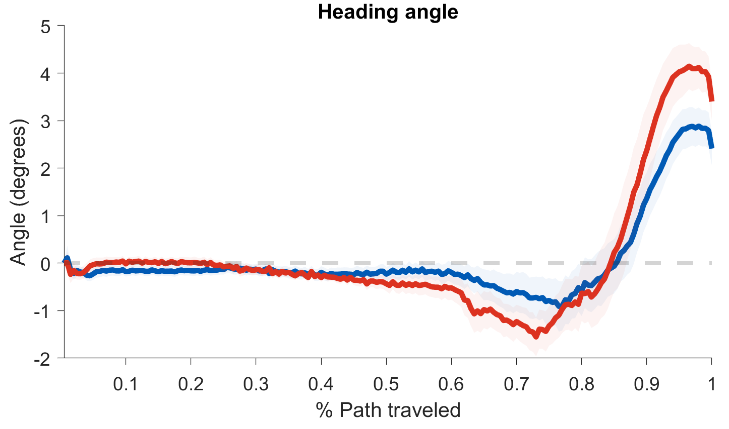
Open Questions
Heading angle
Trajectory SD
Notes:
Heading angle – possible that movement is round, which causes the negative angle, and in the incongruent condition there is a higher bias towards the incorrect answer.
Than the correction of movement is larger.
SD – incon start to vary more than congruent after 50% path.

Slide 42
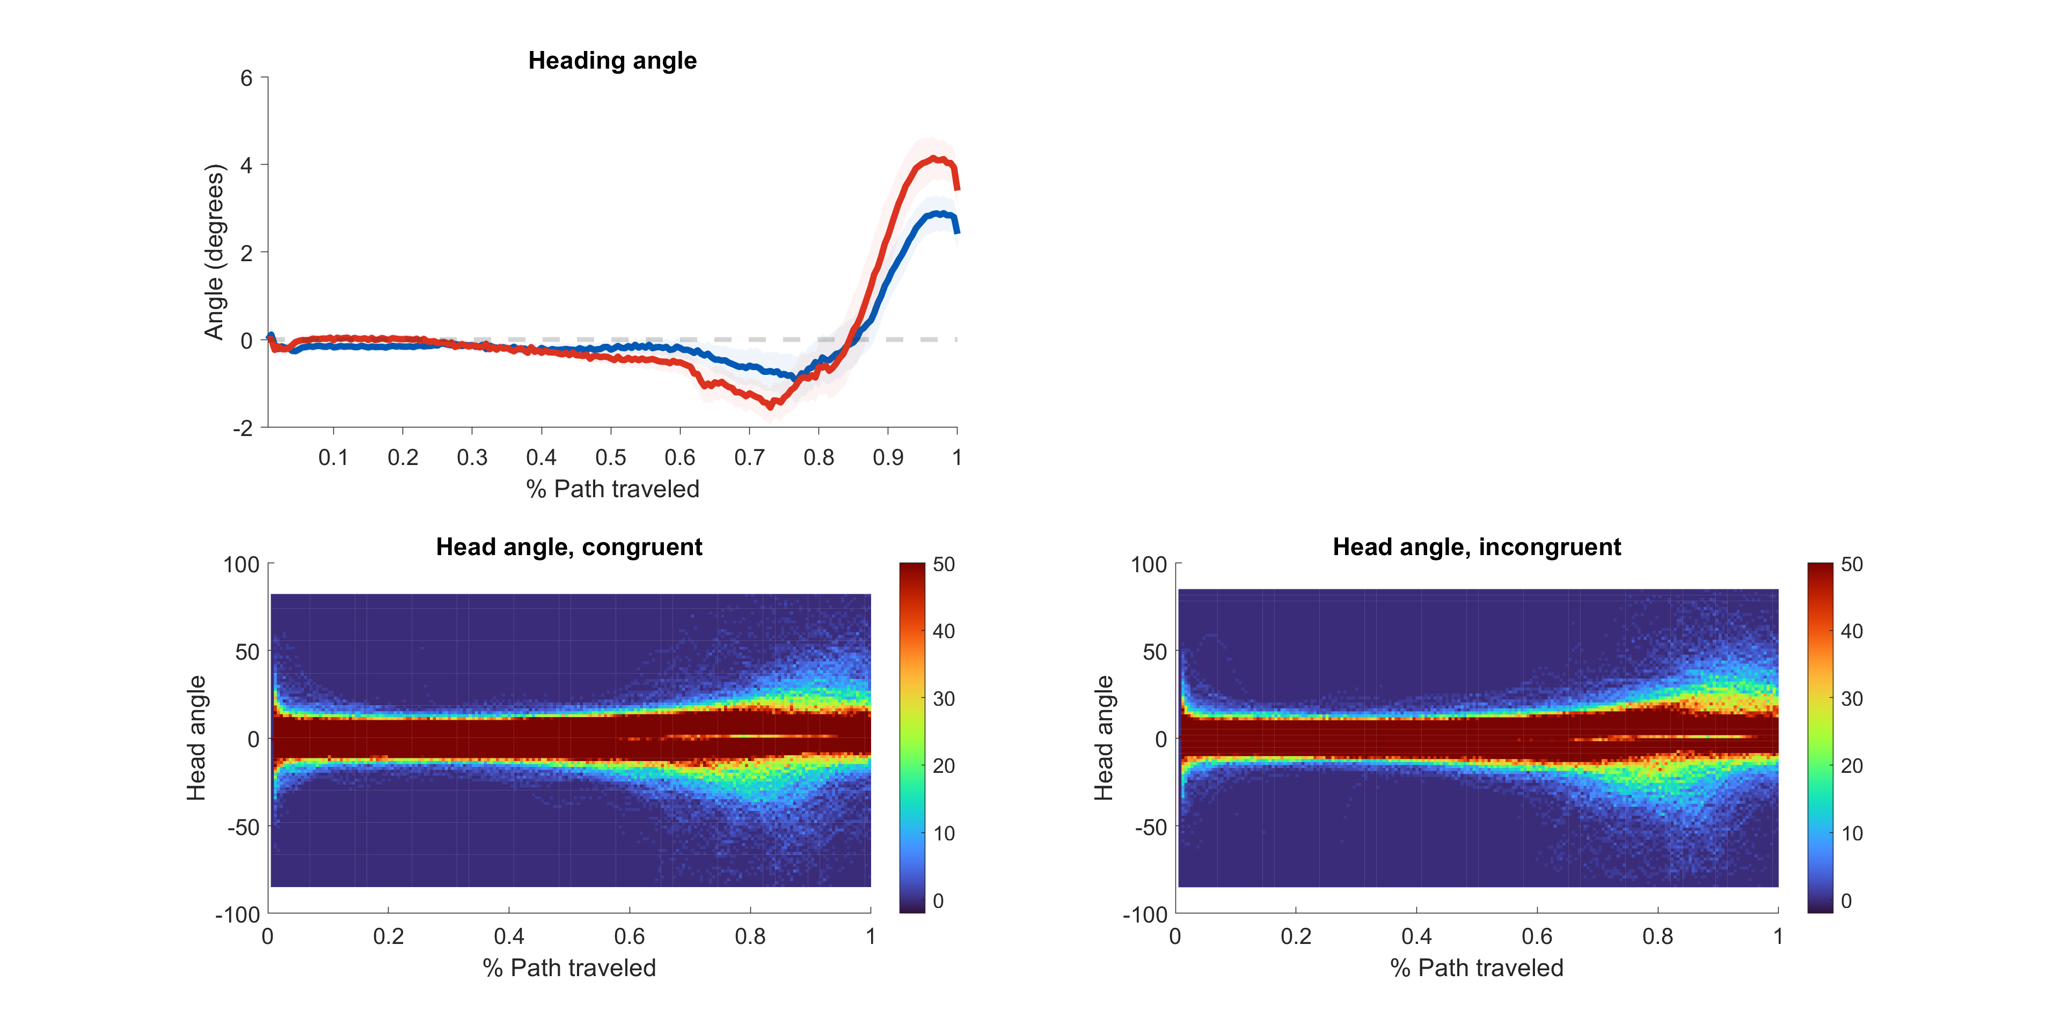
Open Questions
Congruent
Incongruent

Slide 43
Thank you for listening!

Slide 44
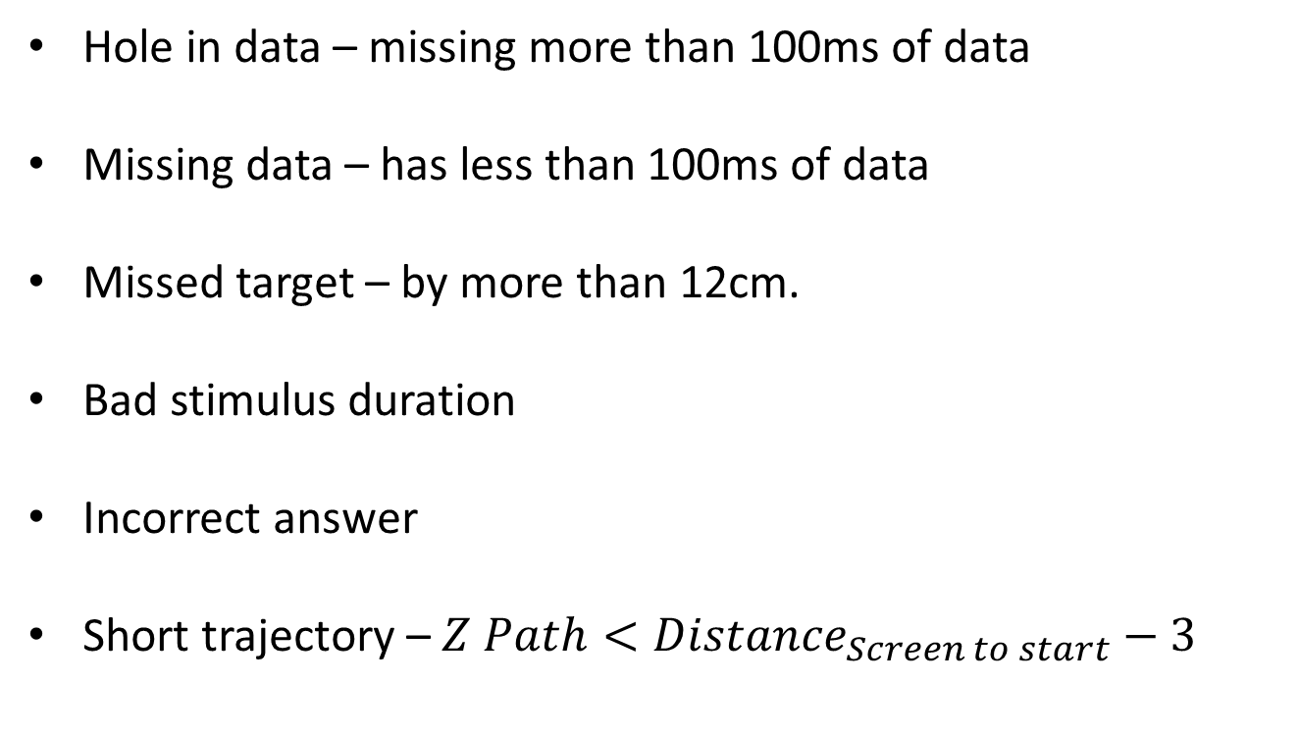
Trial Screening
Hole in data – missing more than 100ms of data
Missing data – has less than 100ms of data
Missed target – by more than 12cm.
Bad stimulus duration
Incorrect answer
Short trajectory – $Z Path<Distance_{Screen to start}−3$
Early response
Exp. 3 < 100ms
Exp. 4 < 100ms
Late response
Exp. 1 > 1500ms
Exp. 2 > 330ms
Exp. 3 > 320ms
Exp. 4 > 320ms
Slow response
Exp. 1 > 1500ms
Exp. 2 > 430ms
Exp. 3 > 420ms
Exp. 4 > 420ms
Notes:
Normalization – B-spline, 6th order, roughness panelty = 10⁻¹⁸ on the 4th derivative, spline at every data point.
Feedback:
Exp 1 – Too late -> interrupts reaching.
Exp 2 – Too late, Too slow -> interrupts reaching.
Exp 3 – Too late, Too slow, Too early -> interrupts reaching.
Exp 4 – Too late, Too early -> interrupts reaching; Too slow -> After reaching.

Slide 45
Distances
 | Exp. 1 | Exp. 2 | Exp. 3 | Exp. 4
Movement onset | 2 | 2 | 1 | 1
Movement offset | 3 | 3 | 1.5 | 0.7
Starting point to screen | 40 | 35 | 35 | 35
Minimal Trajectory length | 37 | 32 | 32 | 32
Notes:
Unit = cm.
Movement onset – distance from starting point at which movement initiation is recognized.
Movement offset – distance from screen at which a touch is recognized.
Minimal trajectory length – shorter trajectories are excluded.

Slide 46
Participant exclusion
Less than 60 trials
Less than 25 trials in each condition
Performance lower than 70% in main task
Prime recognition is above chance (50%)
Notes:
Normalization – B-spline, 6th order, roughness panelty = 10⁻¹⁸ on the 4th derivative, spline at every data point.

Slide 47
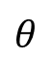


Extracted Variables
AUC
Screen
Screen
Screen
Reach Area
% Path traveled
Right Reach Area
Right Path Area
Left Reach Area
Lowest X value
Lowest X value
Maximal absolute deviation
AUC
Heading angle
Screen
A B
Screen
Screen
$$θ$$
MAD
% Path traveled
% Path traveled
% Path traveled
AUC
X
X
X
Notes:
AUC – consider only part that has the same relation to the optimal path as the center line is to the optimal path. Only the part that is central to the iptimal path.

Slide 48
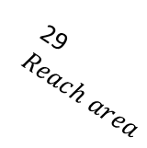
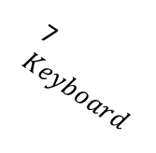
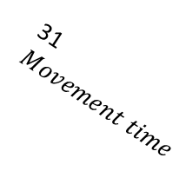
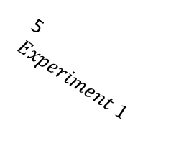
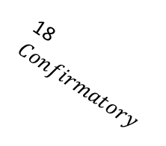
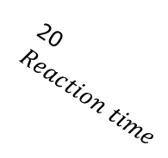


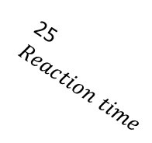
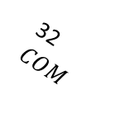
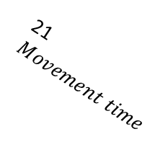
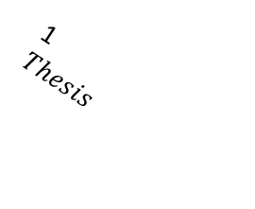
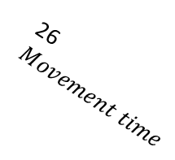
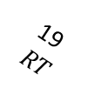

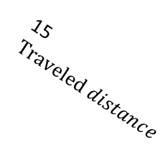
















1
$Thesis$
2
Experiment 4
3
$Experiment 3$
4
$Experiment 2$
5
$Experiment 1$
6
Reach
7$Keyboard$
8$Exploratory$
14$COM$
15$Traveled distance$
16$Reach area$
9
$Confirmatory$
10$Exploratory$
11$Confirmatory$
12$Reaction time$
13$Movement time$
19$RT$
20$Reaction time$
21$Movement time$
22$COM$
23$Traveled distance$
24$Reach area$
25$Reaction time$
17$Exploratory$
18$Confirmatory$
26$Movement time$
27$COM$
28$Traveled distance$
29$Reach area$
30$Reaction time$
31$Movement time$
32$COM$
33$Traveled distance$
34$Reach area$

